Slide 1
I include this on slides where I would like my students to write
down the information into their notes. Use this at your discretion.
Class/paired/individual task Tasks for students are denoted in blue.
Class Brainstorm Class discussion tasks are denoted in green
Personalized information Information that is personal to my class/local area are denoted in purple and will need amending.
Key Words Key words pertinent to the course are denoted in red.
Notes Section Prompts for resource files needed for particular tasks, and any other additional information for the teacher will be given.

Slide 2
Mind Maze! Word ladder…
Turn MICE into RATS!
MICE
-
-
-
RATS
Clues!
Small creature
Win at chess
Floor coverage

Slide 3
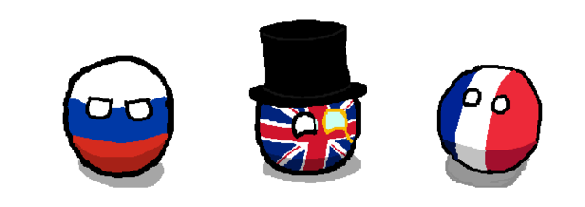
Starter:
Who were the main countries in the Triple Alliance and the Triple Entente?

Slide 4
Conflict and Canada: WWI
Lesson 2:
The Causes of WWI
Part 1 - MANIA

Slide 5
Lesson 2: The Causes of WWI - MANIA
Aims:
✓ Recall the main players in WWI.
✓ Understand the M.A.N.I.A ACRONYM.
✓ Explain FIVE MAIN CAUSES OF WWI.

Slide 6
Read this Scenario…
Gary is a new kid in school. He is very proud and has been trying to get as many friends as he can, partly to have friends, but also so he has someone to help him out if he gets into a fight (which he often does). Gary is also taking steroids and has been lifting weights in the gym every day. Gary’s closest friends are Adrian and Ian.
Frank is a guy in school that has been there for years, he is popular and well known throughout the school. Frank is on the football team, so he is just a strong as Gary, but he isn’t on steroids so he’s not as aggressive. Frank is close friends with Russell, Sebastian, and Gabe.
Notes:
Changes names to suit class members!

Slide 7
Read this Scenario…
Gary is trying out for the football team and wants Frank’s position as quarterback. Although they do not show it, both Gary and Frank want each other out of the school. To hurt each other socially, Frank is trying to become friends with Gary’s friends and Gary has been doing the same. Both are spreading rumors about the other.
One day after practice, Adrian made fun of Sebastian’s family. Sebastian, being very proud of his family took a swing at Adrian and gave him a bloody nose…
Notes:
Changes names to suit class members!

Slide 8
Scenario Questions…
War!
Is Gary a threat to Frank’s status in school? If so, how?
What actions are putting Gary and Frank against each other?
How do you think the incident between Adrian and Sebastian is going to effect Frank, Gary, Ian and Russell?
What do you think would happen if a similar incident happened between a group of countries?

Slide 9
Causes of WWI – MANIA!
We can use the acronym MANIA to remember the main causes of WWI.
What does each letter stand for?
Notes:
Discuss with class – what do they mean?

Slide 10
Causes of WWI – MANIA!
Militarism
Alliances
Nationalism
Imperialism
Assassination
Notes:
Discuss with class – what do they mean?

Slide 11
Causes of WWI – Scavenger Hunt
You will be participating in a Scavenger Hunt to complete the table worksheet given which outlines the MANIA acronym for the causes of WWI.
You must search for the ‘clues’ around the school to complete the table.
The ‘clues’ contain either the definition for each term, or a description of how it contributed to WWI.
There are 10 ‘clues’ in total.
You should summarise the information from the clues and put into your table – no complete copying word for word!
Notes:
Lesson 2 MANIA Table
Lesson 2 Scavenger Hunt Clues

Slide 12
M - Militarism
“The belief that a country should have a strong aggressive military to defend and promote its interests.”
Country’s military receives more funding.
Countries are competing with each other to have the best planes, ships and weapons. Countries began feeling threatened by the amount being spend
Countries competing with each other, trying to outdo each other.
Able to gain more colonies and land than the other industrialized countries they were competing with.
Training more soldiers and had the money to have a larger army.
Using the superior technology to take more colonies.
Military technology, employing more troops, and training their soldiers.
Using new tech. to gain more colonies - all trying to gain more power, very competitive
Notes:
Red italics denotes definition of the MANIA term. Black writing shows the description of the term.

Slide 13
A - Alliances
“Agreements between nations stating that each country will assist the other if they are attacked – countries support each other in times of need.”
Alliances were unions of countries for mutual benefit.
By the 20th C, countries across Europe were getting into alliances with each other for things like trade.
However, these alliances of trade went deeper into alliances of allegiance if war was ever declared.
The alliances included:
The Triple Entente: Russia, Serbia, France, Britain and some African countries
The Triple Alliance: Germany, Italy, Austria-Hungary and some African countries
We will explore this in more detail next lesson!
Notes:
Red italics denotes definition of the MANIA term. Black writing shows the description of the term.

Slide 14
N - Nationalism
“Extreme pride in one’s nation. When a country of group of countries come together with the same desires or interests.”
Countries liked Serbia wanted to be independent.
People became passionate for their own country/group wanting to win leading to tension
Countries had opposition to their desired interest…leading to tension
Unification of countries/regions with the same ideas, values, history
Different ideas between ethnic groups from nation to nation Ethnic groups wants to rule themselves.
Don’t like people who are different from themselves. Believed culture was superior to other
People identify with regions/ethnic groups as opposed to their ruling empire
More people began joining military to support countries conquest efforts.
People strongly attach to their country/regions culture Citizens wanted to help county, felt passionate about war
inspired the people in the country to actually fight for their country.
Ethnic groups in empires wanted to rule themselves.
Notes:
Red italics denotes definition of the MANIA term. Black writing shows the description of the term.

Slide 15
I - Imperialism
“The search and acquisition of land for; raw materials to fuel industry, markets to buy and sell goods. This leads to countries competing with each other.”
Increase tension between countries since they were competing for the same market.
Led to hostility and tension in countries boarder, countries were fighting for more land. (included the people the colonies)
Helped create weapons for the War. Materials came from foreign nations.
Expanded military bases in colonized countries
They fought to claim colonies to get raw material - made the countries more power because they have more land/raw materials —> more money - Added smaller fights on areas of spheres of influence contributing to more problems.
Countries in Europe used up their own natural resources. Needed to look elsewhere. - countries are going to want more and more land - resources fueled militarism and nationalism (feel loud and proud) - completive with other nations —> small fights to emerge.
Tension between countries because fighting over resources and land - Competitiveness, over land. Not sure who would over the other.
Land disputes fueled tension between the countries in Europe
Notes:
Red italics denotes definition of the MANIA term. Black writing shows the description of the term.

Slide 16
A - Assassination
“The planned killing or murder of a specific person – usually a high-profile figure.”
Increased Nationalism, between Austria Hungary (AH) towards Serbia.
Alliances declaring war on each other.
AH lost its crowned prince, they were angry toward Serbia
AH losing control over nationalist regions
Germans in Austria, Magyars in Hungary)
AH annexed Balkans provinces, Balkans felt closer to south Russia.
June 28 1914, the Archduke Franz Ferdinand of Austria-Hungary visited the capital of Bosnia (Sarajevo) which had been taken over by Austria-Hungary in an earlier conflict. On that day, a Serbian member of a radical nationalist group, called the Black Hand, assassinated the Archduke and his wife, Duchess Sophia. The assassination forced Austria-Hungary to declare war on Serbia.
Notes:
Red italics denotes definition of the MANIA term. Black writing shows the description of the term.

Slide 17
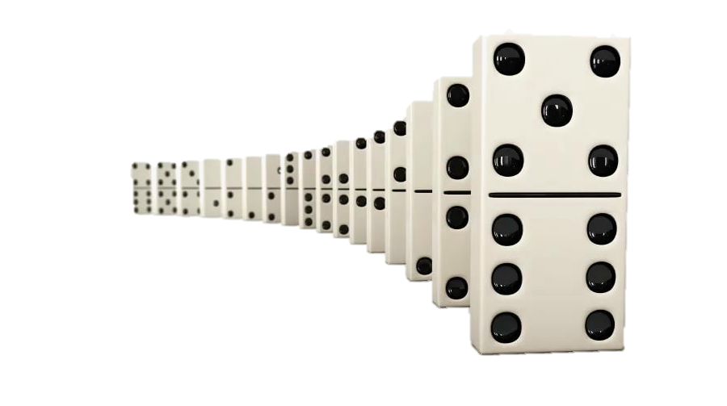
Assassination The Final Straw!
Domino Effect
1. Austria Hungary blamed Serbia for Ferdinand’s death and declared war on Serbia.
2. Germany pledged their support for Austria-Hungry.
3. Russia pledged their support for Serbia.
8. Britain supports Belgium and declares war on Germany.
4. Germany declares war of Russia.
5. France pledges support for Russia.
6. Germany declares war on France.
7. Germany invades Belgium on the way to France.

Slide 18
Review: Find it!! Hard - Find 5 different political cartoons which represent the 5 aspects of MANIA. Medium - Find 5 different political cartoons which represent the 5 aspects of MANIA. Easy - Find 5 different political cartoons which represent the 5 aspects of MANIA.
Notes:
Discuss with class

