Slide 1
Notes for Presentation
I include this on slides where I would like my students to write
down the information into their notes. Use this at your discretion.
Class/paired/individual task Tasks for students are denoted in blue.
Class Brainstorm Class discussion tasks are denoted in green
Personalized information Information that is personal to my class/local area are denoted in purple and will need amending.
Key Words Key words pertinent to the course are denoted in red.
Notes Section Under each slide prompts for resource files needed for particular tasks, and any other additional information for the teacher will be given.

Slide 2
Riddle me this…
I have roads, but no cars,
Forests, but no trees…
There is no sand in my deserts,
And no water in my seas.
What am I?
Notes:
Answer: A Map

Slide 3
Starter…
Key words for today’s lesson are Globalisation and Containerisation.
On your post-it notes, write down a definition for each and pin to the board.
Notes:
Answer: A Map

Slide 4
Lesson 1 What is Trade?
Unit I – Business, Trade, and the Economy

Slide 5
Learning Objective:
To learn about international business and trade.
Learning Outcomes:
Define trade, globalisation and interdependence.
Describe the history of Canada’s trade.
Define globalisation.
Explain the opportunities and threats of trade for Canada.

Slide 6
International Business
Business – the manufacturing and/or sale of goods and/or services to satisfy the wants and needs of consumers to make a profit
Domestic Business – makes transactions within the borders of the country in which it is based (domestic market).
International Business – conducts transactions between businesses in different countries (foreign market).

Slide 7
International businesses could…
Own a retail outlet in another country
Own a manufacturing plant in another country
Export to businesses in another country
Import from businesses in another country
Invest in businesses in another country

Slide 8
Trade
Foreign trade or international trade mean the same as international business
If a business in one country develops a relationship with business in another country, those countries are considered trading partners

Slide 9
History of Canadian Trade
European Trade
Grew rapidly during the 1700’s
Finished goods brought from Britain and France
Furs, fish and lumber sent to Europe
All goods travelled by ship
Canada’s historical connection with Britain continues today

Slide 10
History of Canadian Trade
United States
Became independent from Britain in late 1700’s, had to become self-reliant
Inventions such as the steam engine (1775) led to the growth of American industry, including population growth.
Canada supplied raw materials to U.S.
U.S. continues to be our largest trading partner

Slide 11
History of Canadian Trade
Asia
Started after WWII, late 1940’s as Japan’s industries were rebuilt
Japan produces high-quality electronics, automobiles and equipment
China emerging in last 30 years as a major economic force due to liberalization of communist policies
China and Japan in Canada’s top 5 trading partners

Slide 12
History of Canadian Trade
Mexico
North American Free Trade Agreement (NAFTA) signed in 1993
Goods made in Canada, U.S. and Mexico cross borders duty-free (a duty or tariff is a tax placed on imports in order to make domestic goods competitive)
Trade has increased greatly since NAFTA.

Slide 13
Emerging Markets
Future markets emerge as potential trading partners grow such as:
Middle East
India
Africa

Slide 14
Canada’s Top 10 Trading Partners
Imports 2015 (millions)
United States | 285,200
China | 65,650
Mexico | 31,197
Germany | 17,341
Japan | 14,776
United Kingdom | 9,195
Korea, South | 7,877
Italy | 7,372
France | 6,804
Taiwan | 5,457
Total All Countries | 535,604
Exports 2015 (millions)
United States | 402,173
China | 20,221
United Kingdom | 15,952
Japan | 9,772
Mexico | 6,594
India | 4,321
Korea, South | 4,027
Hong Kong | 3,914
Germany | 3,612
Netherlands | 3,556
Total All Countries | 524,049

Slide 15
Individual Task: Where is it made…
Choose 10-20 manufactured items in your possession and record where they were made on the blank world map given.
Notes:
Resource: Lesson 1 World Map
Source PrintableWorldMap.net

Slide 16
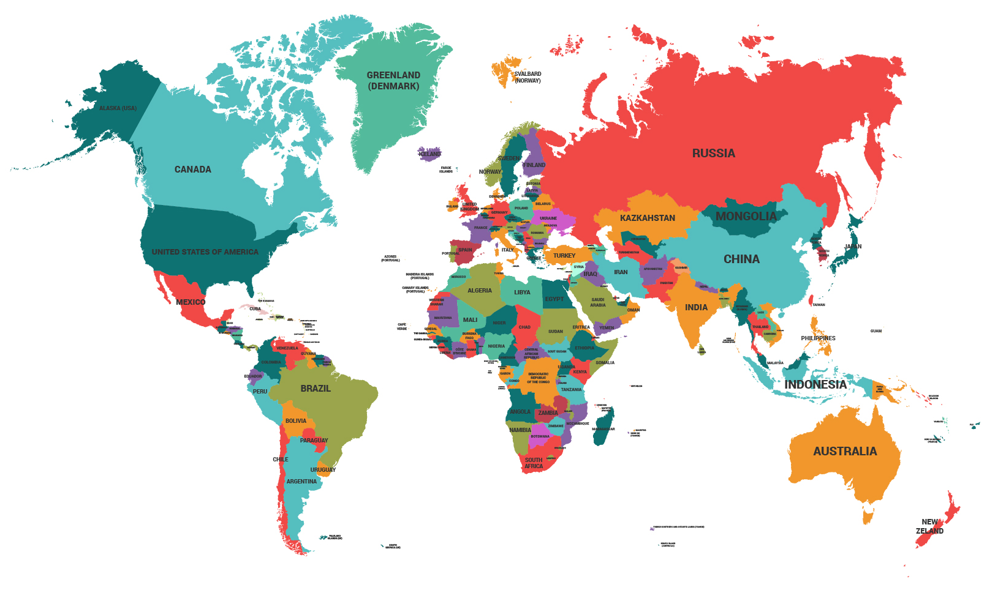
Notes:
Discuss responses to the previous task with students
Source: Designed by Freepik.com

Slide 17
Individual Task: Canada vs. USA
Compare statistics of Canada vs. the United States of America using the handout provided
Be able to make some observations about the statistics collected!
Use the CIA World Factbook https://www.cia.gov/library/publications/the-world-factbook/index.html
Canadian trade data online http://www.ic.gc.ca/epic/site/tdo-dcd.nsf/en/Home
Notes:
Resource: Lesson 1 Canada and US Factsheet

Slide 18
What is Globalisation
“The process by which businesses or other organizations develop international influence or start operating on an international scale.”

Slide 19
What is Globalisation?
A buzzword that describes International Trade
There have been many changes over the past 25 years in the way we do business
Reduction in trade barriers
EU – 1993
NAFTA – 1994
WTO - 1995

Slide 20
Globalisation
Began after World War II with establishment of the United Nations
Trade relations developed, and treaties negotiated
Increased rapidly due to:
New Technology and Communications
Socio-Political Issues: developing economies, free trade agreements, etc.

Slide 21
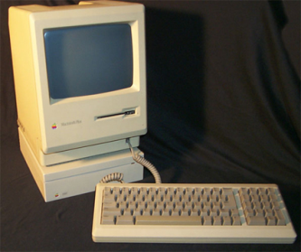
Changes over 25 years
New & Improved telecommunications

Slide 22
Improvements in the past 100 years
What do you notice about the following?
Charges for using satellites
Avg revenue per air transport passenger mile
Avg charge for ocean freight & port charges per ton.
Cost of a 3-minute telephone call from NY to London

Slide 23
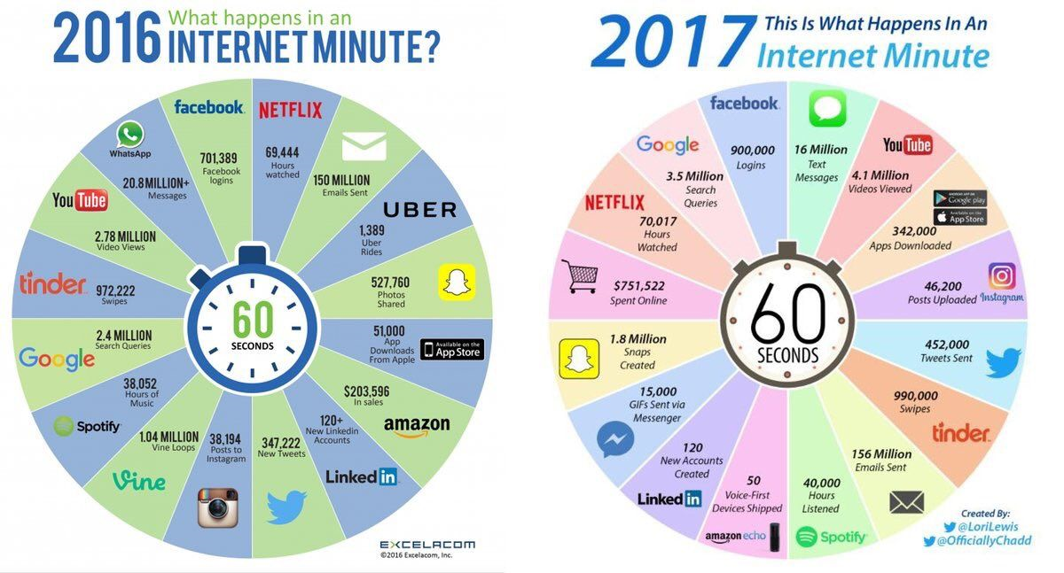
What do you notice about the following?

Slide 24
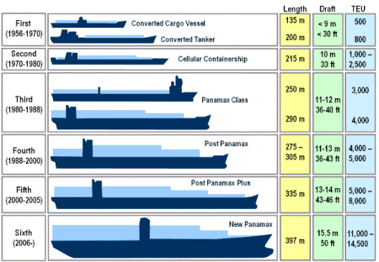
More Efficient Transportation
What do you notice about the following?

Slide 25
Improvements in Transportation
What process do the following photos show?
Notes:
Answer: Containerisation

Slide 26
What process do the following photos show?
Notes:
Answer: Containerisation

Slide 27
What process do the following photos show?
Notes:
Answer: Containerisation

Slide 28
Containerisation - What is it?
Notes:
https://ed.ted.com/lessons/how-containerization-shaped-the-modern-world#watch

Slide 29
Individual Task – Infographic
Containerisation fueled globalisation, and in the video that’s portrayed as a positive thing.
But some people are concerned that these shipping containers might be contributing to some darker aspects of globalisation, like human trafficking and terrorism.
About 95% of the cargo that comes into the U.S. arrives by sea. Who’s checking it, and how? Is it possible to look after national security without significantly slowing down international trade? How do security measures at the docks compare with airports, train stations, and other places?
Conduct some research and create an infographic with your answers.

Slide 30
Other changes in 25 years
The creation of new free-market economies
Fall of communism in Eastern Europe
Rise of China

Slide 31
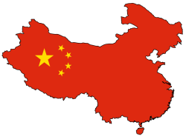
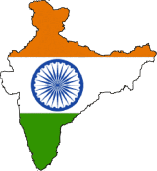
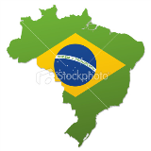
Review: An Evolving World: Guess the six largest economies in each year…
Largest Economy in 2003 | Largest Economy in 2025 | Largest Economy in 2050

