Slide 1
I include this on slides where I would like my students to write
down the information into their notes. Use this at your discretion.
Class/paired/individual task Tasks for students are denoted in blue.
Class Brainstorm Class discussion tasks are denoted in green
Personalized information Information that is personal to my class/local area are denoted in purple and will need amending.
Key Words Key words pertinent to the course are denoted in red.
Notes Section Prompts for resource files needed for particular tasks, and any other additional information for the teacher will be given.

Slide 2
Starter: Fun Facts About Soil!
Read the following statements about soil.
Which ones surprise you the most? Why?
Notes:
Discuss answers with the class.

Slide 3
70,000 Different types of soil in Canada
1 Tablespoon of soil has more organisms in it than there are people on earth
5,000 Different types of bacteria in one gram of soil
.01 Percent of the earth’s water held in soil
15 Tons of dry soil per acre that pass through one earthworm each year
1,400,000 Earthworms that can be found in an acre of cropland
20,000 Pounds of total living matter in the top six inches of an acre of soil
10 Percent of the world’s carbon dioxide emissions stored in soil
Notes:
Discuss answers with the class.

Slide 4
The Physical Environment
Lesson 7. Soil and Vegetation

Slide 5
Lesson 7.
Soil and Vegetation
Learning Goals:
Name Canada’s seven vegetation regions.
Describe the seven vegetation regions.
Describe and explain Canada’s climatic regions.

Slide 6
Characteristics of Soil
Soil is a naturally occurring, unconsolidated or loose material on the surface of the earth, capable of supporting life
Soil is made up of four components (MOMA):
Minerals - come from a parent material (rock), provides nutrients to plants
Organic Material/ Bacteria- decaying materials release nutrients
Moisture- dissolves nutrients, decays organic materials
Air - roots need air pockets. Created by worms, insects, and small animals that burrow in the soil

Slide 7
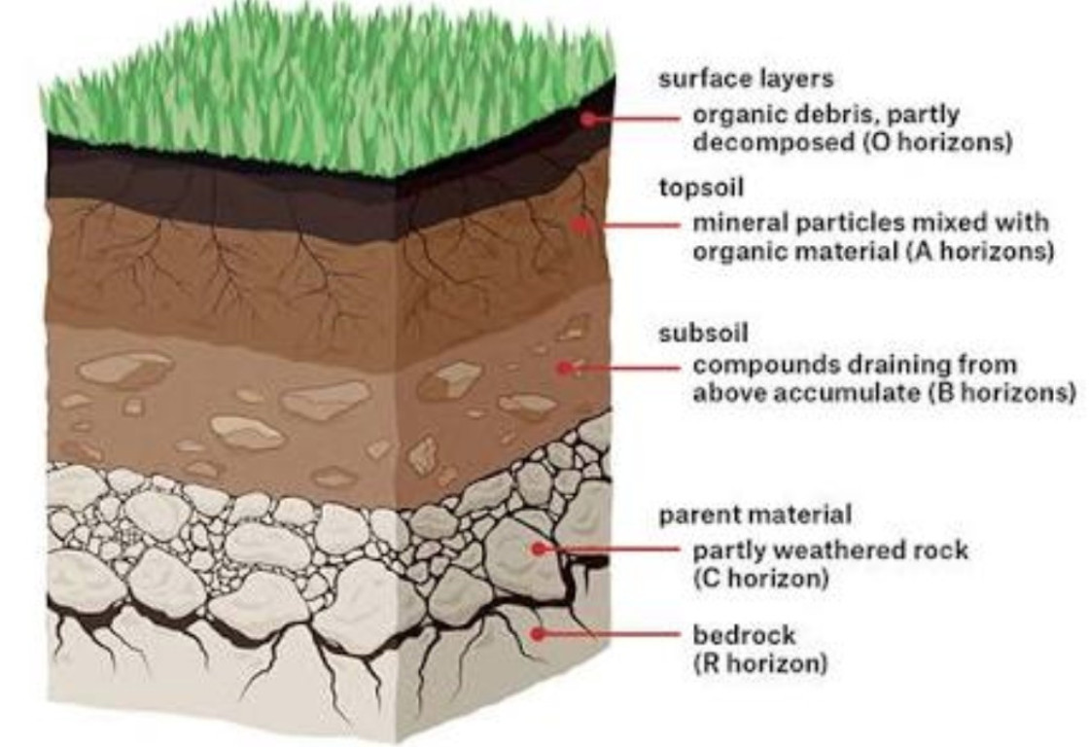
Task 1. Copy this diagram.

Slide 8
Vegetation Patterns
Canada has SEVEN main types of vegetation:
Tundra
Boreal Forest
Grassland and Parkland
West Coast Forest
Broad-leave Forest
Mixed Forest
Cordilleran Vegetation

Slide 9
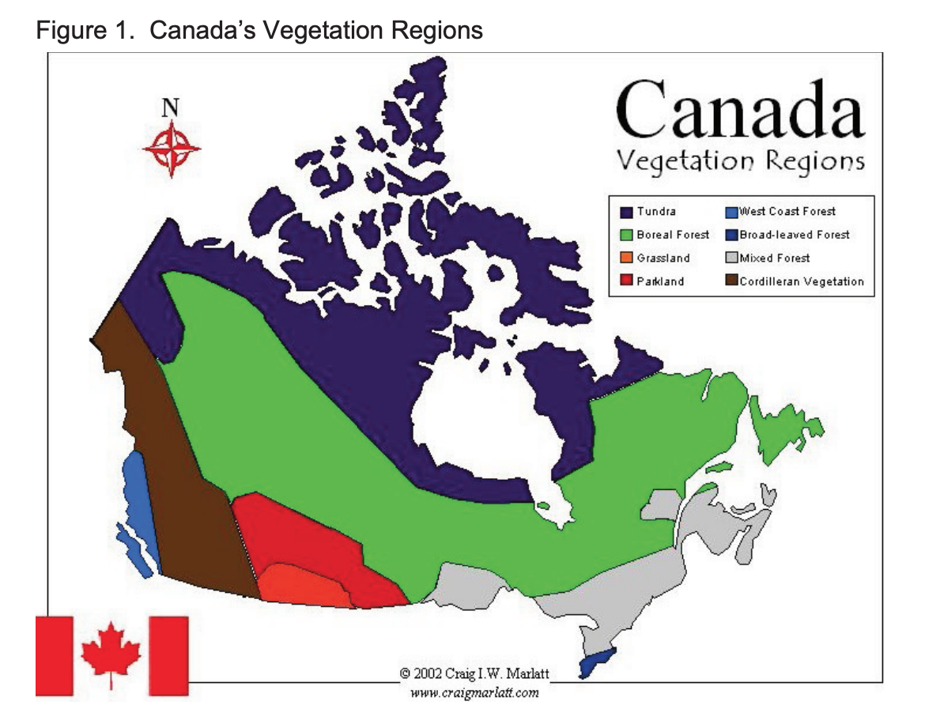
Tundra
Boreal Forest
Grassland and Parkland
West Coast Forest
Broad-leave Forest
Mixed Forest
Cordilleran Vegetation

Slide 10
Vegetations Regions
Task 2: Scavenger Hunt
Around the school are posters about each of the seven vegetation regions.
Your task is to find each region and describe it in less than 50 words!!!
Notes:
Lesson 7 Vegetation regions

Slide 11
Ecozones
An ecozone is an area of the earth’s surface that has a unique combination of plants, wildlife, climate, landforms, and human activities.
If you were to overlay or combine the climate, landforms, soil (and vegetation) regions of Canada, you would see patterns emerge resulting in Canada’s 15 terrestrial (land) ecozones.

Slide 12
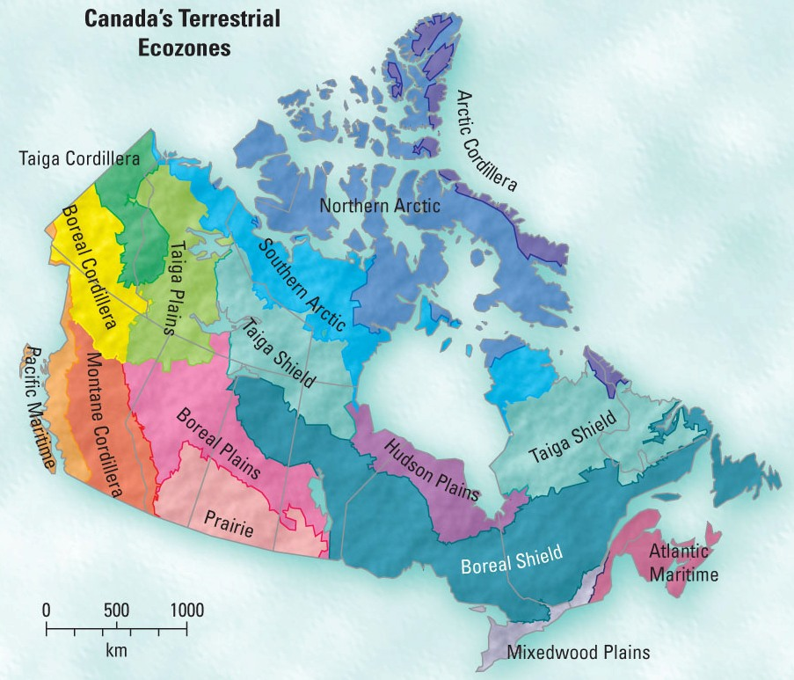
Ecozones

Slide 13
Review: Regions Web Quest
Task 3: Web Quest
Complete the Web Quest worksheet provided! Who will be the fastest?!!!
Notes:
Lesson 7 Regions Webquest

