Slide 1
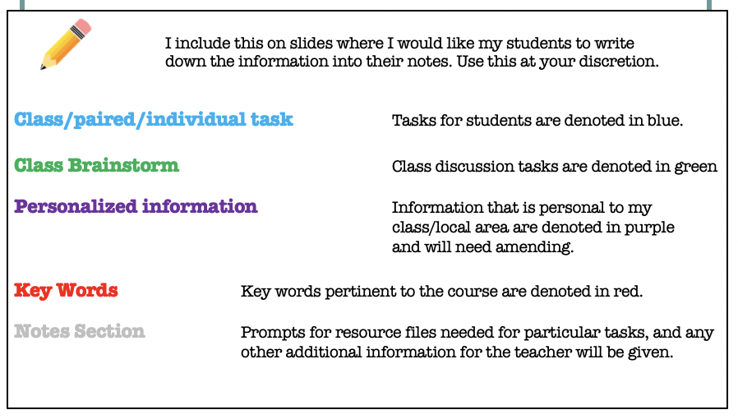
Notes for use

Slide 2
Starter
You have been given a product. You have three minutes to think of how you can sell the product to other people in the room.
You are then going to stand up and try and sell the product with your best sales pitch to other people in the room.
How many people say they will buy your product & how many will they buy?
Is business and selling as easy as that?
Notes:
Resource: Bring in some items for the class to sell! Or use items from your classroom.

Slide 3
Lesson 8: The Marketing Mix | Part 1
Unit 2: Functions of a Business

Slide 4
Lesson 8. The Marketing Mix | Part 1
Lesson Objective:
To learn about the marketing mix.
Lesson Outcomes:
Explain the marketing mix.
Explain explain each element within the marketing mix and give examples of how each can impact on the objectives of a business.
Create a marketing mix for a given business.

Slide 5
Worlds Oldest McDonald’s
This 51 year-old site is the oldest in the worldwide chain of 20,000 restaurants and the last one with red-and-white striped tile exterior.
After opening in 1953, it immediately became the standard for the fast food franchises across the country.
Employees wear 50's style uniforms of paper hats, white shirts and bolo ties.
The restaurant serves the original menu of hamburgers, cheeseburgers, fries and old-fashioned milkshakes.

Slide 6
MCDONALD’S IN INDIA
McDonald’s India, a subsidiary of McDonald’s USA, has expanded its presence in India via 2 joint venture companies – Connaught Plaza restaurants and Hard Castle restaurants.
Connaught Plaza restaurants manages operations and expansions across North India (Delhi, Jaipur and Punjab) – led by Vikram Bakshi
Hardcastle restaurants, which is headed by Amit Jatia, manages operations and expansions across Western India (Mumbai, Pune, and Gujarat).
McDonald’s worldwide is well known for the high degree of respect to the local culture. McDonald's has developed a menu especially for India with vegetarian selections to suit Indian tasted and culture.

Slide 7
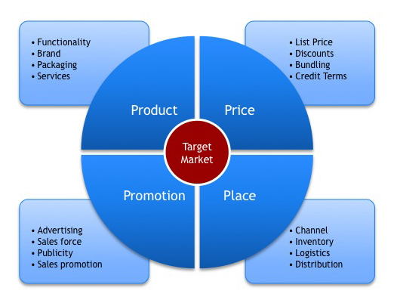
Notes:
Resource: Lesson 2 Marketing Mix Handout (use as a resource for notes as you go through powerpoint (slides 8-45).

Slide 8

The Marketing Mix
‘The marketing mix is a recipe for effective marketing. Using the marketing mix when planning the marketing for a product allows for a consistent approach’
Getting a good balance of the 4 Ps will mean an effective marketing campaign

Slide 9
1. Price
The main pricing strategies are:
  Competitive pricing
  Cost-plus pricing
  Penetration pricing
  Price skimming
  Destroyer pricing
  Price discrimination
  Promotional pricing
  Price bundles
  Task 1: Complete the Match up activity to define each of the key terms above.
Notes:
Resource: Lesson 8 Marketing Mix Handout

Slide 10
Competitive pricing
Where the amount of competition in the market is strong so customers have a wide choice of suppliers to buy from businesses must set their prices close to the prices of competitors, having regard to the quality of the product and any unique selling points (USPs)
Notes:
Answers for definition match up (slides 11-18)

Slide 11
Cost-plus pricing
This is the simplest pricing strategy and is aimed at ensuring the business covers its costs and makes an acceptable profit. The total costs of producing one unit of the product are calculated to which is added the required profit margin. This gives the selling price.

Slide 12
Penetration pricing
In penetration pricing the product’s price is set significantly lower than any competitors’ prices when the product first enters the market
This pricing strategy may be used where the objective is to enter or capture a larger share of the market, but may yield a low profit or even a loss in the short run.
The price is usually raised later

Slide 13
Price skimming
Where a new product is likely to generate a high volume of initial sales (because it is a new product) a high price may be charged in order to maximise profits.
The price will be reduced when the initial high demand has subsided.

Slide 14
Destroyer pricing
A destroyer pricing strategy involves setting a price so low that competitors cannot match it.
In this way they will lose customers and be driven out of the market.
The price can then be raised without threat of competition.

Slide 15
Price discrimination
Some times it is possible to discriminate between types of customer for the same product, perhaps based on usage or quality.
Car insurance companies, for example, commonly discriminate on the basis of age and perceived risk.

Slide 16
Promotional Pricing
Often big promotions are offered when a product is launched.

Slide 17
Price Bundles
Sometimes companies offer discounts if you buy multiple products at once, or two/three different products together as a package.

Slide 18
Mc Pricing
Penetration
Skimming
Competition
Pricing Strategies
Promotional
How do McDonalds use each of these pricing strategies – can you give examples of each?
Bundle
Value
Notes:
Use McDonalds as the example for the pricing strategies examples column.

Slide 19
Promotional Pricing:
If you have driven past a McDonald’s, you will notice that somewhere on their property, whether it is a banner on their building or spelled out on their sign, they are always offering some sort of promotional pricing.
Penetration Pricing:
When McDonald’s first began to break into the coffee market, they ran a large marketing campaign in order to gain some market share in the industry. For a limited time frame, you could get a free small coffee every morning from 4-7am. This was to promote their new coffee partnership with Green Mountain Coffee and helped spread the word that McDonald’s was now offering coffee.
Value Pricing:
“This approach is used where external factors such as recession or increased competition force companies to provide 'value' products and services to retain sales.” The most notable and recent example of this is McDonald’s “Dollar Menu.” The Dollar Menu was created because McDonald’s recognized that the economy was in a decline and that their competition was getting fiercer. The Dollar Menu satisfies the current decreasing economy and has increased the pressure towards competitors. The introduction to the Dollar Menu is by far the most economical product line that McDonald has ever offered. You can get a number of products off of their menu for only a dollar. It is efficient and practical
Notes:
Answers to McDonalds pricing question

Slide 20
2. Product
"Anything that is capable of satisfying customer needs"
The process by which companies distinguish their product offerings from the competition is called branding.
For most companies, brands are not developed in isolation - they are part of a product group.
A product group (or product line) is a group of brands that are closely related in terms of their functions and the benefits they provide (e.g. Dell's range of personal computers or Sony's range of televisions).

Slide 21
Portfolio planning
Businesses should manage their products carefully over time to ensure that they deliver products that continue to meet customer wants.
The process of managing groups of brands and product lines is called portfolio planning.
One model of product portfolio planning that is widely known and used in business:
  The Boston Matrix

Slide 22
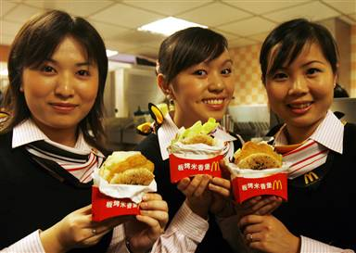
MCDONALD’S Products - China
McDonald's offers regional versions of its menu (glocalisation).
McDonald's Chinese New Year meal, grilled chicken sandwich and twisted French fries
the Chicken McNuggets come with the traditional BBQ, Sweet & Sour, and Honey Mustard sauces, but there's also a chili garlic sauce (very popular in China )
McDonald's restaurants and counters for ice cream, beverages, and desserts (otherwise rare in China)
Grilled Chicken Burger, curly fries, with a horoscope of the twelve zodiac animals of Chinese astrology and traditional "red" packets, or gift bags, for monetary gift giving as good luck.

Slide 23
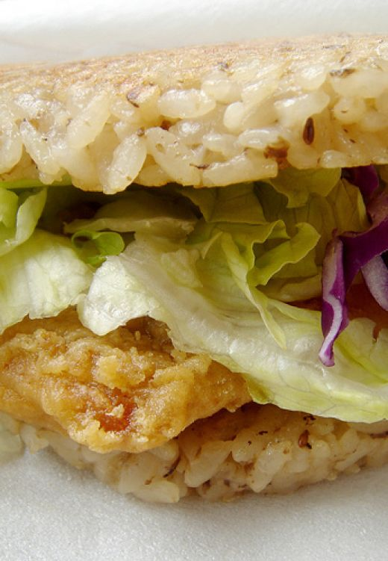
MCDONALD’S Products - Hong Kong
McDonald's sells beef, chicken and pork burgers.
Fried chicken wings and nuggets are also popular.
Some restaurants have a section for the McCafé.
Apart from the general menu, it also promotes some other foods seasonally or longer, like spicy french fries, the Shogun Burger, Grilled Chicken Burger, twisted macaroni breakfasts, salads, soups, pineapple or red bean sundae, pineapple pies, taco flatbreads with pork, beef or chicken, rice fan-tastic (a burger-like entree with rice patties in place of buns) and many others.
It also sells many toys or dolls, like Hello Kitty, Snoopy, and Disney figures in addition to set meals, which are very popular
In Kowloon Park, there is also a small counter named Snack Station selling ice cream, as well as a counter that sells McDonald's drinks in the swimming pool.

Slide 24
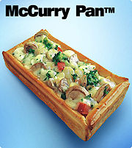
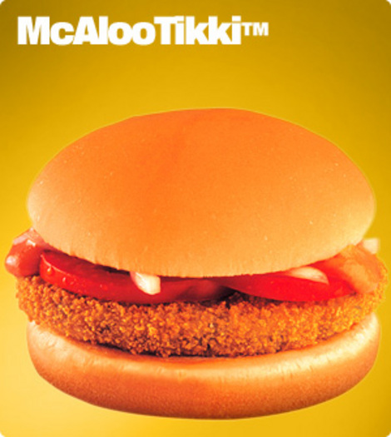
MCDONALD’S Products - India
The McCurry Pan is a very popular dish across India.
Chicken (only Halal) along with fish are the only meat
products used.
Paneer-Salsa wrap and the Chicken-Mexican wrap
Curry pans in Shahi-Paneer and Chicken-Tikka
McChicken Burger and Chicken McGrill
McAloo Tikki Burger
McVeggie
McSurprise burger. It contains a patty, onion,
Italian mayonnaise.
Pizza McPuff

Slide 25
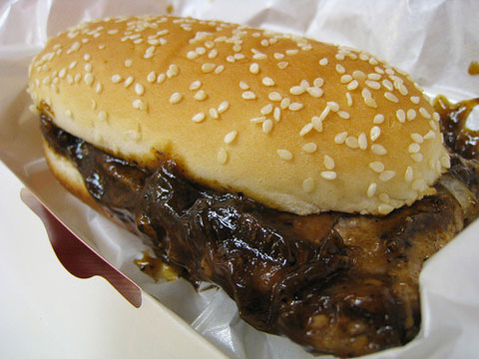
MCDONALD’S Products - Malaysia
Ayam Goreng McD –
A crispy two piece fried chicken meal.
Chicken McDeluxe
Bubur Ayam McD -"chicken porridge"
Bubur Ikan McD -fish porridge/congee
Burger consisting of four beef patties- the Mega Mac

Slide 26
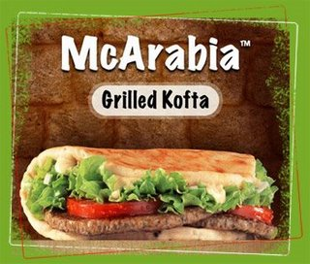
MCDONALD’S Products - Malaysia
Spicy McChicken burger.
McChutney Burger
Meatball sandwich called the McKofta
Strawberry custard pie
McArabia

Slide 27
3. Place
Place is about ensuring that supplies of a product are available on the market for potential purchasers to buy.
Distribution is vital in order to make sure that this happens.
It is likely that a producer will use one of three models to distribute their product on to the market- what will yours be??

Slide 28
3. Place

Slide 29
Model A
Model A is the traditional model of distribution.
In this model a wholesaler buys in bulk from a producer, and then sells (and often delivers) smaller quantities to retailers, who in turn sell even small quantities to customers.
This process of breaking up large, bulk purchases from producers into smaller quantities for resale to retailers is known as BREAK BULK.

Slide 30
Model B
Model B is typically used by large retailers (e.g. Walmart, Loblaws, Presidents Choice).
Because they are so large, they are able to take on the role of the wholesaler.
Such companies have Regional Distribution Centres (RDC) to which producers can deliver in bulk, and from where smaller quantities can be sent to retail stores in the area served by the RDC.

Slide 31
Model C
Model C is known as DIRECT SELLING and is generally used by producers or suppliers (e.g. Computer manufacturers, Insurance Companies) who wish to target a niche or specialist market.
This is often done through:
Direct Mail to chosen customers (e.g. Car insurance to members of the AA or RAC)
Mail Order Catalogues (e.g. Book Clubs)
Advertisements in specialist publications (e.g. Computer magazines)
Telesales (e.g. Double glazing)
Teleshopping (e.g. QVC)

Slide 32
Mc Place
The organisation must distribute the product to the user at the right place at the right time. Efficient and effective distribution is important if the organisation is to meet its overall marketing objectives
McDonald's is the largest chain of fast food restaurants in the world. It has a total of more than 31,000 outlets worldwide.
McDonald's has become emblematic of globalisation, sometimes referred as the "McDonaldisation" of society
McDonald's works on the supply chain management

Slide 33
4. Promotion
The main objectives of promotion are
  To inform prospective customers of the product and the business
  To show the benefits of the product
  To persuade potential customers to buy the product
  To present a good image

Slide 34
4. Promotion
Your businesses objectives may include
  To increase market share
  To enter a new market or market segment
  To extend the life of a product
  To launch a new product into a market
The success of a promotional campaign must be measured against these objectives

Slide 35
Methods of Promotion
Price reductions, special offers and free gifts persuade new customers to try a product and can give a boost to sales and that lasts longer than the promotion
Free samples can increase awareness of a new product
Competitions attract customers to new and existing products

Slide 36
Methods of Promotion
Brochures and catalogues inform customers about a product and present an image of the business
Point of sale promotion such as in-store displays encourage impulse buying
Internet based using a web site and e-mail depends on customers knowing where to look and providing an e-mail address
After sales involves providing service backup and information as well as warranties and guarantees

Slide 37
Methods of Promotion
Advertising should be targeted using
  Television: expensive and wide coverage
  Radio: cheaper and smaller audience; no visual stimulus
  Cinema: local audience
  Newspapers and magazines: can be expensive but more specialised; if kept can be long lasting
  Posters: cheaper; have impact but may be ignored; little opportunity for targeting
  Leaflets: delivered to peoples homes or distributed in the street; cheap but little opportunity for targeting

Slide 38
Methods of Promotion
Public relations
  Press releases and news stories released to the press can provide cheap promotion that can be targeted by using trade press
  Sponsorship of events and television programmes bring the product or business to peoples’ awareness but can be expensive
  Endorsement by celebrities associates the product with the celebrity

Slide 39
Mc Promotion
“You Deserve a break today, so get up and get away- To McDonald’s”
The above break commercial was one of the initial commercial themes adopted by McDonald’s US, which became the best known commercial song on television and, in fact, the most identifiable advertising themes of all time.
Needham was one of the first advertising agencies of McDonald’s
McDonald’s is now, one of the world’s mightiest consumer marketers. Its brand valuation is around $25 billion, making the ninth most valuable brand in the world.

Slide 40
Mc Promotion
Advertising
Public Relation
Sales Promotion
Promotional Mix
Personal Selling
Direct Mail
Internet/
E-Commerce

Slide 41
Budgeting for the campaign
McDonald’s has a huge budget that allows them to target whatever market they see as beneficial.
They are able to change their advertising strategy as often as they change their menu.
      McDonald's is Your Kind of Place (1967)
      McDonald's and You (1983)
      Have you Had your Break Today? (1995)
      I'm lovin' it (2003)

Slide 42
Selecting the Media to Use
McDonald’s use celebrities from all over to promote to the target audience in each country.
    LeBron James and Dwight Howard

Slide 43
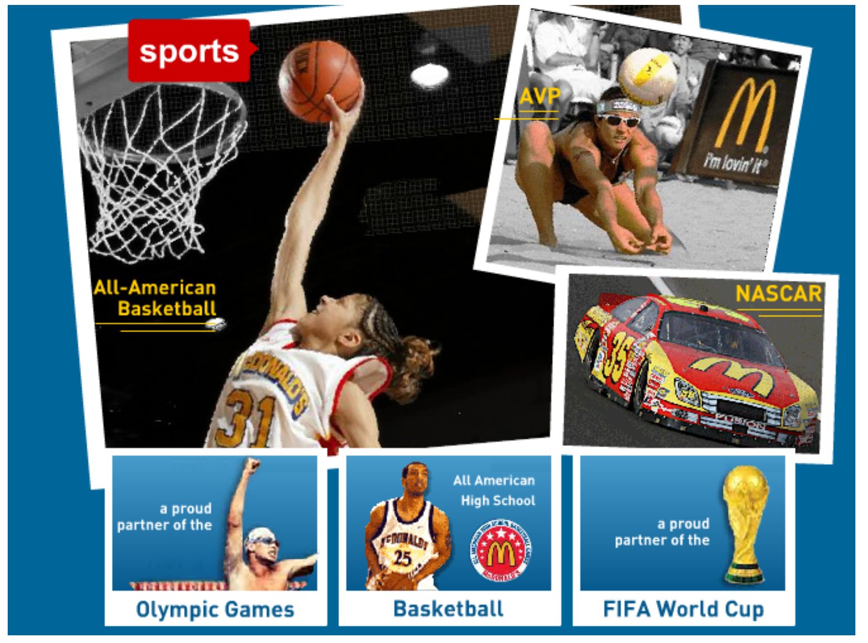
Scheduling of ads Using Olympic Athletes in timing for the Winter Olympics.
Get name associated with best athletes in the world, will reflect their athletes in the world, will reflect their new, improved healthy menu and new, improved healthy menu and choices

Slide 44
Selecting the Media to Use
McDonald's and Sony Computer Entertainment teamed for an online/offline PlayStation Portable (PSP) giveaway called "Only the MAC CODE Knows."
The promotion -- aimed at attracting a young people who buy a Big Mac sandwich or large fries get a code that they can enter online at the PlayatMcD.com Web site.
Once on the site, users can learn about the promotion and see prizes to be won.
Additional site features - a "Game Reader" to help visitors select games
McDonald’s are also the founders of the Ronald McDonald House Charities

Slide 45
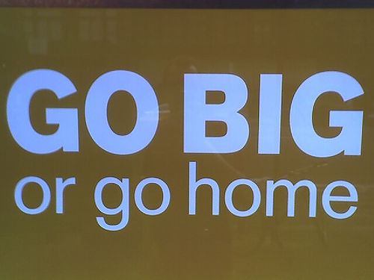
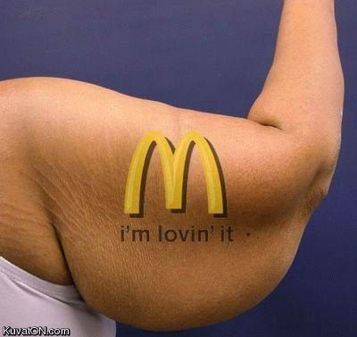
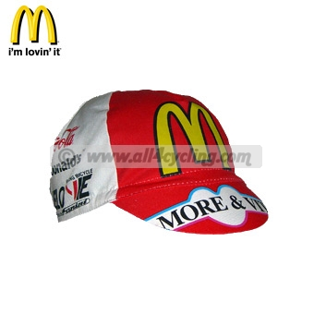

McDonald's slogans
Have You Had your Break Today?
My McDonald's
Did Somebody Say McDonald's?
Enjoy More
Only McDonald's
A Visit To McDonald's Makes Your Day
McDonald's - It Can Happen
We Love to See/Make You Smile
Put a Smile On
There's a little McDonald's in Everyone
Things that make you go 'mmm'
Every time a good time
I’m lovin it
Feed Your Inner Child

Slide 46
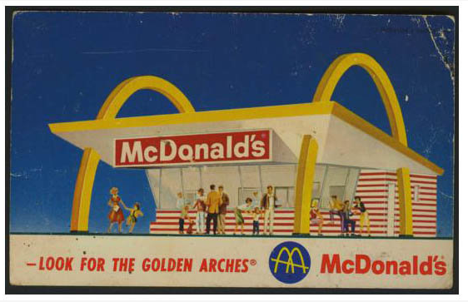
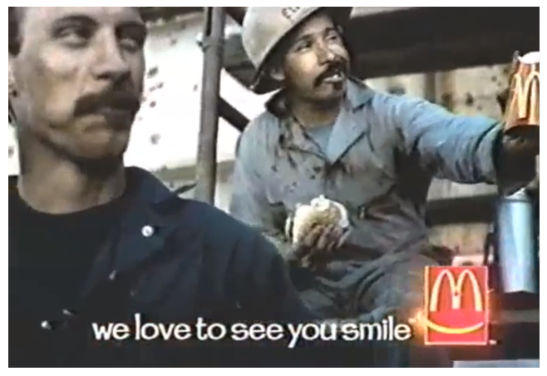
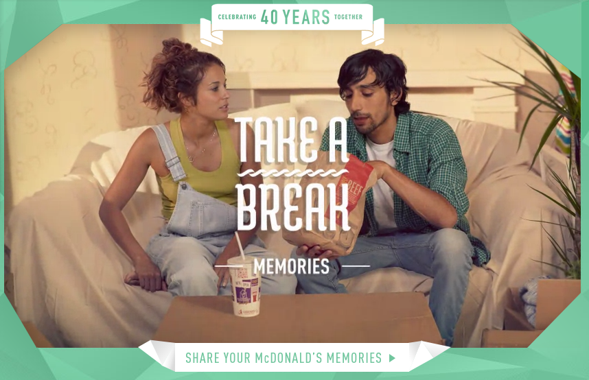
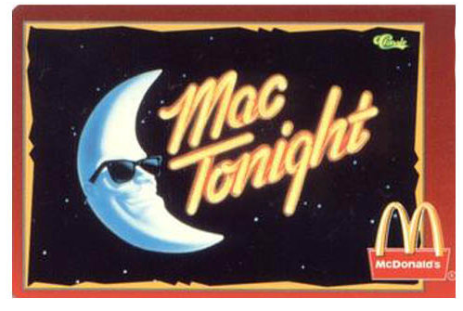

Slide 47
We All Scream for Ice Cream!!
Task 2.
Using the websites linked on the learning platform compare the marketing mix for the three ice cream brands.
Record your findings in the table given.
Notes:
Resource: Lesson 8 We all Scream for Ice Cream Task

Slide 48
Review: We All Scream for Ice Cream!!
Discuss your findings with a partner.

