Slide 1
Notes for Presentation
I include these on slides where I would like my students to
write down the information into their notes.
Use this at your discretion.
Student task Tasks for students are denoted in blue.
Class Brainstorm Class discussion tasks are denoted in green.
Personalized information Information that is personal to my class/local area are denoted in purple and will need amending.
Key Words Key words pertinent to the course are denoted in red.
Notes Section Under each slide prompts for resource files needed for particular tasks, and any other additional information for the teacher will be given.
Add to notes

Slide 2
Curriculum Objectives
B2.1 use appropriate terminology related to astronomy.
B1.1 analyse a major milestone in astronomical knowledge or theory (e.g., the discovery of the red shift in the spectra of galaxies; the knowledge gathered from the particle accelerator experiments at CERN in Switzerland), and explain how it revolutionized thinking in the scientific community

Slide 3
Starter: Astronomy Word Cloud
Class Task:
Using www.wordart.com create a word cloud using all the words that spring to mind when you think of Astronomy.
Notes:
Lesson 1 Starter
Image Source: https://www.pexels.com/photo/white-clouds-2114014/

Slide 4
Unit 1 Lesson 1 History of Astronomy

Slide 5
Lesson 1. History of Astronomy
Learning Objective:
To learn about the history of astronomy.
Lesson Outcomes:
✓ List the main developments and discoveries in astronomy.
✓ Describe some major historical changes which have occurred in astronomical concepts.
✓ Give examples of what we used to believe and why, and what new technology did to change our view of the universe.

Slide 6
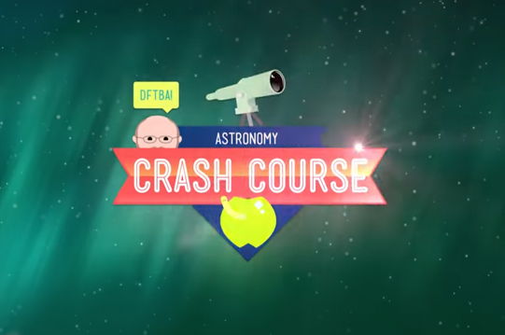
Crash Course | What is Astronomy?
Task 1.
Watch this episode of Crash Course Astronomy.
Write down a definition of Astronomy and what it seeks to discover.
Crash Course #1 | Introduction to Astronomy

Slide 7
What is Astronomy?
Add to notes
“Astronomy is a natural science that studies celestial objects and phenomena. It uses mathematics, physics, and chemistry in order to explain their origin and evolution. Objects of interest include planets, moons, stars, nebulae, galaxies, and comets.”

Slide 8
The Roots of Astronomy
0
Already in the stone and bronze ages, human cultures realized the cyclic nature of motions in the sky.
Monuments dating back to ~ 3000 B.C. show alignments with astronomical significance.
Those monuments were probably used as calendars or even to predict eclipses.
Notes:
Image Source: https://www.pexels.com/photo/stonehenge-england-1448136/

Slide 9
Stonehenge
0
Constructed 3000 – 1800 B.C. in Great Britain
Alignments with locations of sunset, sunrise, moonset and moonrise at summer and winter solstices
Probably used as calendar.

Slide 10
Important Figures in Astronomy
Ptolemy
Copernicus
Notes:
Students to use Lesson 1 Worksheet to complete whilst going through presentation

Slide 11
Ptolemy 150AD
Add to notes
Like Aristotle, I believe that the Earth is the centre of the universe. The sun and five planets orbit us. Boom.
Notes:
Image Source: https://www.pexels.com/photo/planet-earth-87651/

Slide 12
Problems With the Geocentric Model
Add to notes
The planets appear to change brightness, implying a change of distance.
The planets undergo retrograde motion (they move backwards compared to the direction the Sun moves).
The Sun, Moon, and Planets do not move at the same speed all the time.
Mercury and Venus are never seen at opposition (they always appear close to the Sun.

Slide 13
Copernicus 1543
Add to notes
I don’t believe Ptolemy’s theory. He doesn’t have a clue mate. I believe the sun is at the centre of the universe. Earth is just one of five planets that orbit it.
The Earth spins on its axis, that’s why it appears the stars and our sun moves across the sky. Oh yes, I’m so clever!
Notes:
Image Source: https://www.pexels.com/photo/sun-fire-hot-research-87611/

Slide 14
Evidence of the Heliocentric Model
Add to notes
The changing brightness of the planets is explained by the Earth getting closer and farther from the planets during our orbit of the Sun.
Our passing planets explain the retrograde motion of the outer planets.
Mercury and Venus are not seen at opposition because they orbit the sun, just as we do.

Slide 15
Problems with the Heliocentric Model
Add to notes
The changing speeds of the Sun, Moon, and planets is not explained by simply placing the Sun at the center of the universe.
We do not feel the Earth moving or the atmosphere being pulled away as we fly around the Sun.
If the Earth were spinning, wouldn’t we be thrown off into space?
Why is there no parallax due to our spin or our orbit?

Slide 16
Galileo 1632
Add to notes
I have built a telescope. Pretty pleased with myself actually. Copernicus is right, the planets do orbit the sun.
Copernicus was worried about the church’s views, so didn’t publish his ideas until just before his death. I’m going to go for it...

Slide 17
Galileo
Your theories are blasphemy! You shall be placed under house arrest!
Galileo continued studying our sun and the universe and played the ultimate price for science.
I cannot forget what I have seen. I will continue to study the universe.

Slide 18
Kepler
Newton
Circular orbits mean the planets are not in the right place at the right time. The orbits must be elliptical.
Gravity is the force that causes this shaped orbit. And it shall be measured in me, the Newton!
Notes:
Image Source: https://www.pexels.com/photo/blue-and-brown-milky-way-galaxy-2694037/

Slide 19
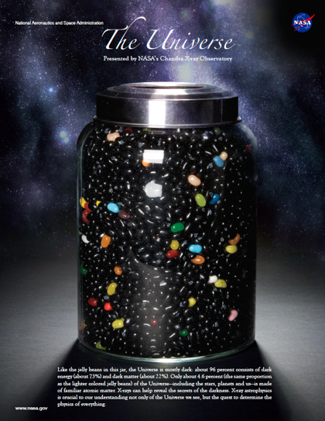
Review: Jelly Bean Universe!
Class Task:
Study the infographic ‘The Jelly Bean Universe,’ which portrays the universe as a jar of jelly beans.
Can you create your own portrayal of the universe?
Bring to class next lesson!
Notes:
Lesson 1 Review
Image Source: Nasa

