Slide 1
Notes for Presentation
I include this on slides where I would like my students to write
down the information into their notes. Use this at your discretion.
Class/paired/individual task Tasks for students are denoted in blue.
Class Brainstorm Class discussion tasks are denoted in green
Personalized information Information that is personal to my class/local area are denoted in purple and will need amending.
Key Words Key words pertinent to the course are denoted in red.
Notes Section Under each slide prompts for resource files needed for particular tasks, and any other additional information for the teacher will be given.

Slide 2
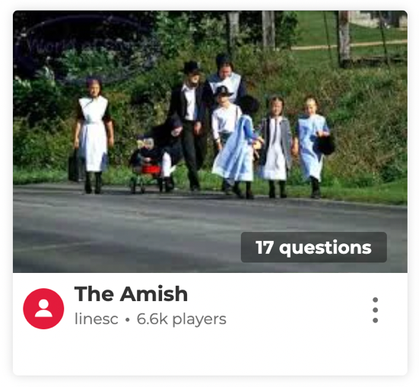
Starter… Kahoot Quiz!!
Notes:
Source: www.kahoot.com – The Amish

Slide 3
Lesson 5 Globalisation and The Amish [Part 2]
Unit 3 – Power and Policies

Slide 4
Learning Objective:
To learn about how globalization has impacted upon the Amish people.
Learning Outcomes:
Describe who the Amish are.
Explain how globalization has impacted upon the Amish.
Analyse how the Amish have adopted and resisted globalization.
Assess the quality of the life of the Amish.

Slide 5
Documentary Lesson
Living with the Amish

Slide 6
Living with the Amish
Part 1
Part 2
Task 1.
As we watch the documentary series ‘Living with the Amish’ Outline how the six British teenagers from the UK will find life challenging in a contemporary non-globalized society.
Be specific and give examples from the documentary to support your answer.
Part 3
Part 4
Part 5
Part 6

Slide 7
Assignment 3.1 | The Amish and Globalisation Essay
Respond to the following statement in the format of an essay:
"The Amish, despite their resilience, will be unable to resist the spread of globalisation"
To what extent do you agree with this statement?
See assignment document for more details.
Notes:
Assignment 3.1 | Amish and Globalisation Essay

