Slide 1
I include this on slides where I would like my students to write
down the information into their notes. Use this at your discretion.
Class/paired/individual task Tasks for students are denoted in blue.
Class Brainstorm Class discussion tasks are denoted in green
Personalized information Information that is personal to my class/local area are denoted in purple and will need amending.
Key Words Key words pertinent to the course are denoted in red.
Notes Section Under each slide prompts for resource files needed for particular tasks, and any other additional information for the teacher will be given.

Slide 2
Riddle me This…
Notes:
Answer: Friday

Slide 3
Starter…
Class Discussion:
What were some of the limitations with using HDI as a tool to measure development?
Does Canada have disparities within the country, or is everyone equal?
Notes:
Discuss responses with students.

Slide 4
Lesson 3 Measuring Global Disparities The Lorenz Curve
Unit 2 – Global Disparities

Slide 5
Learning Objective:
To learn about the The Lorenz Curve and Gini Coefficient.
Learning Outcomes:
Define and explain the the Lorenz Curve and Gini Coefficient.
Interpret and draw the Lorenz Curve and Gini Coefficient.

Slide 6
Global Development
To combat the limitations of the HDI, we can also measure disparities WITHIN a country using a graph known as the Lorenz Curve.

Slide 7
The Lorenz Curve and Gini Coefficient
Developed by Max. O. Lorenz in 1905
Graphical representation of income distribution
Portrays observed income distribution and compares this to a state of perfect income equality.
Notes:
Discuss slides 7 – 10 (students to take notes)
Resource: Can use the video linked on Global Geek to help explain

Slide 8
The Lorenz Curve and Gini Coefficient
Shows the percentage of households plotted on the x-axis and income percentage on the y-axis.
In a perfectly equal income distribution, every person has the same income. For the Lorenz curve, the bottom N% of society would always have N% of the income, and a perfectly equal distribution would be a straight line y = x.
In a perfectly unequal distribution, one person has all the income and everyone else has none.
Notes:
Discuss slides 13 – 16 (students to take notes)
Resource: Can use the video linked on Global Geek to help explain.

Slide 9
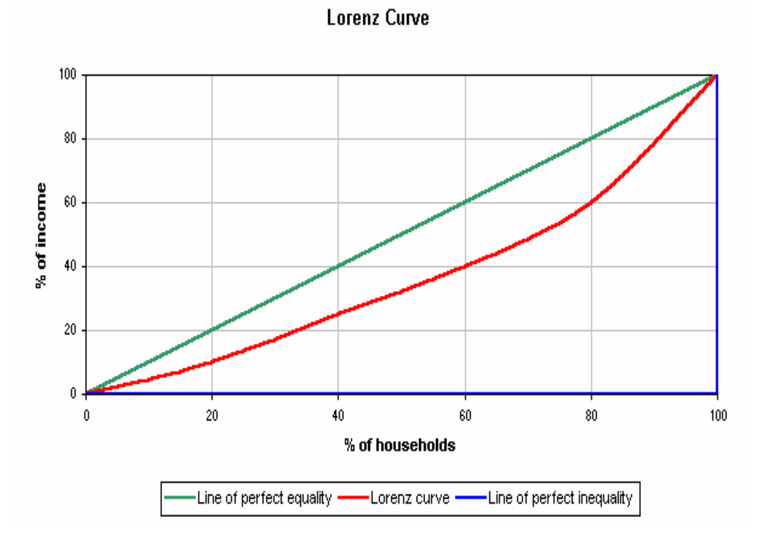
Notes:
Ask students to draw this into their notes
Source: worldbank.org

Slide 10
The logic for a perfectly equal income (i.e., equal distribution) is 10% of the population would have 10% of the income, 20% or the population would have 20% of the income, and so on. Thus, the Lorenz curve in perfectly equal income is a straight line.
It is more common for incomes to be distributed unevenly through a population.
The more the line curves to the right the more unequal income distribution becomes.
Discuss: The Lorenz curve cannot rise above the line of perfect equality. Why?

Slide 11
Notes:
Discuss graph with students – point out differences between countries

Slide 12
Question: Do you need to do anything with this data before you plot it?
Table 1. Distribution of wealth in Canada
Percentage of households | Percentage of Income
20 | 5.7
40 | 11.8
60 | 17.7
80 | 24.6
100 | 40.2
Task 1: Graph the data in Table 1 and Table 2 to build a Lorenz Curve for each dataset.
Table .2 Distribution of wealth in the world
Percentage of households | Percentage of Income
20 | 1.4
40 | 1.9
60 | 2.3
80 | 11.7
100 | 82.7
Notes:
Will need graph paper for this activity.

Slide 13
Task 1: Graph the data in Table 1 and Table 2 to build a Lorenz Curve for each dataset.
Table 1. Distribution of wealth in Canada
Percentage of households | Percentage of Income
20 | 5.7
40 | 11.8
60 | 17.7
80 | 24.6
100 | 40.2
Cumulative Frequency
5.7
17.5
35.2
59.8
100
Table .2 Distribution of wealth in the world
Percentage of households | Percentage of Income
20 | 1.4
40 | 1.9
60 | 2.3
80 | 11.7
100 | 82.7
Question: Do you need to do anything with this data before you plot it?
Cumulative Frequency
1.4
3.3
5.6
17.3
100
Notes:
The graph will not be accurate unless the cumulative frequency has been calculated.

Slide 14
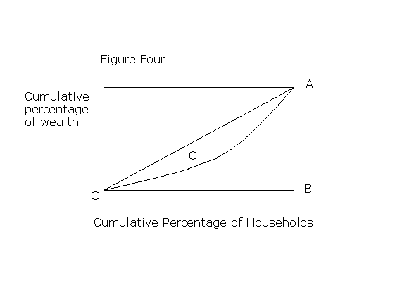
The Gini Coefficient
The Gini Coefficient is a complementary way of presenting information about inequality.
It is the ratio of the area between the Lorenz Curve and the line of absolute equality (numerator) and the whole area under the line of absolute equality (denominator).
The Gini Coefficient = C/0AB.
Notes:
Discuss slides 14 – 16 (students to take notes)

Slide 15
The Gini Coefficient
The extreme values of the Gini Coefficient are 0 and 1.
These are often presented in statistical publications as percentages. Hence, the corresponding extreme values are 0% and 100%.
0 or 0% implies perfect equality (in other words, everyone in society has exactly the same amount of wealth)
1 0r 100% implies total inequality in that one person has all the wealth and everyone else has nothing.
The lower the figure that Gini Coefficient takes (between 0% and 100%), the greater the degree of prevailing equality.

Slide 16
Discussion: Which country is the most equal and which country is the least equal in terms of population income distribution?
Country | Gini, % | Year
Argentina | 48.3 | 2006
Australia | 35.2 | 1994
Belgium | 33.0 | 2000
El Salvador | 52.4 | 2002
European Union | 31.6 | 2003
Finland | 26.9 | 2000
France | 26.7 | 2002
Germany | 28.3 | 2000
India | 36.8 | 2004
Japan | 38.1 | 2002
Morocco | 40.0 | 2005
Nigeria | 43.7 | 2003
Russia | 40.5 | 2005
United Kingdom | 36.0 | 1999
United States | 45.0 | 2004
Yemen | 33.4 | 1998
Notes:
Answers: MOST = France LEAST = El Salvador

Slide 17
Some facts…
Most developed nations have a GINI Index of between 0.24 and 0.36.
Canada = 33.7
UK = 32.6
USA = 45 – 4th HIGHEST FROM HIGH RANKING in HDI
South Africa = 63.38 HIGHEST
Azerbaijan = 16.64 LOWEST

Slide 18
Task 2
https://ourworldindata.org/income-inequality/
1. Visit the website above and have a look at the map showing the Gini Coefficients for the countries.
2. Have a look at the top 10 countries for HDI that you wrote down earlier. Record their Gini Index. How do these countries compare in terms of income inequality?
Notes:
Students to answer questions 1 – 7 into their notes.

Slide 19
3. Make a list of some countries who rank the best on the Gini Index (have the lowest score)
4. What region of the world are these countries found?
5. What might be the reasons for this?
6. Which countries rank the worst?
7. What might be the reasons for this?
Notes:
Students to answer questions 1 – 7 into their notes.

Slide 20
Review:
Class Discussion:
Why is it important for governments to know the development of a country?
Why is it important for governments to know difference in inequalities within a country?

