Slide 1
Notes for Presentation
I include this on slides where I would like my students to write
down the information into their notes. Use this at your discretion.
Class/paired/individual task Tasks for students are denoted in blue.
Class Brainstorm Class discussion tasks are denoted in green
Personalized information Information that is personal to my class/local area are denoted in purple and will need amending.
Key Words Key words pertinent to the course are denoted in red.
Notes Section Under each slide prompts for resource files needed for particular tasks, and any other additional information for the teacher will be given.

Slide 2
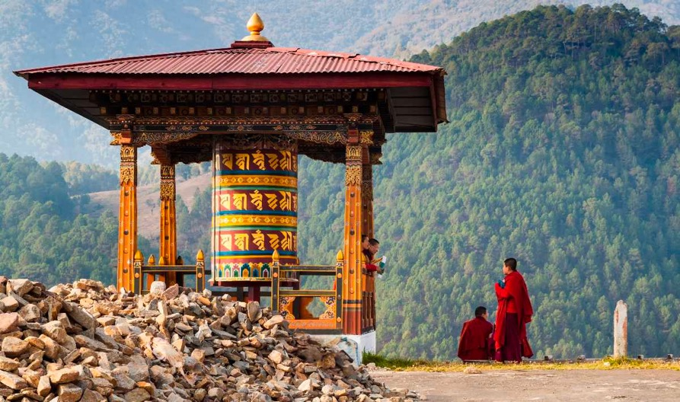
Starter… Guess the Country!
This country is a landlocked country located in Eastern Himalayas in Southeast Asia.

Slide 3
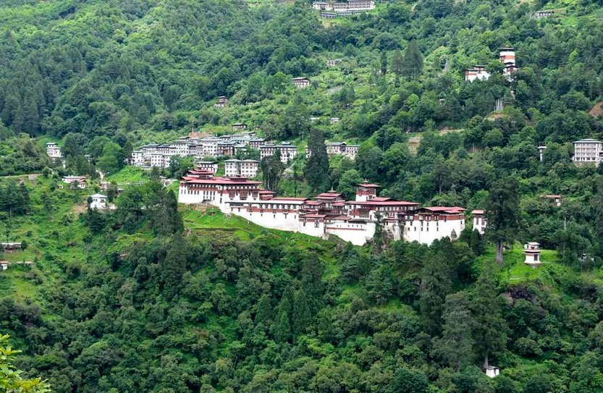
Starter… Guess the Country!
This country is the only carbon negative country in the world, which means that it absorbs more carbon dioxide than it produces.

Slide 4
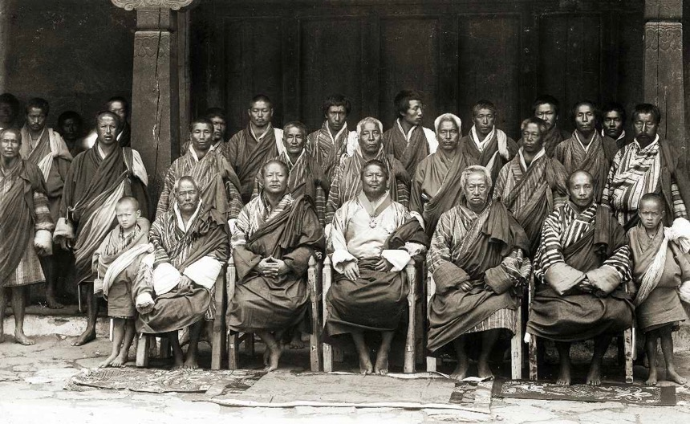
Starter… Guess the Country!
This country was isolated entirely from the world until 1974 when media was allowed to cover the new king’s coronation, about 64 years since it was found.

Slide 5
Starter… Guess the Country!
This country has the highest unclimbed peak in the world! Gangkhar Puensum is the highest mountain in Bhutan and has never been conquered. It has an elevation of 7570 metres.

Slide 6
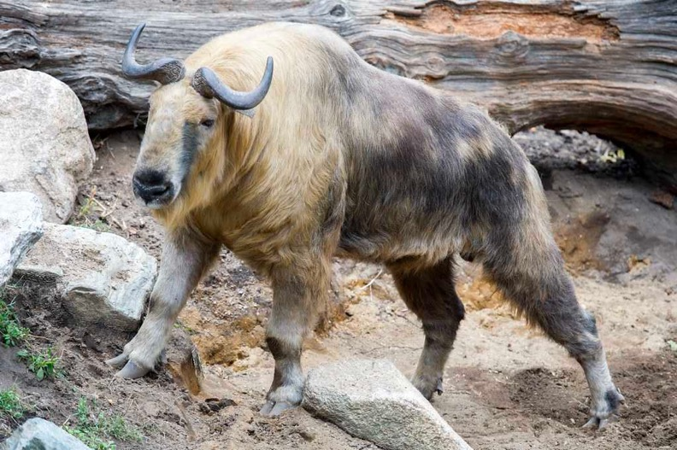
Starter… Guess the Country!
The national animal of this country is “Takin”, a goat-antelope. It is endemic to the country. It was thought to be a mythological creature before an Englishman discovered that it existed.

Slide 7
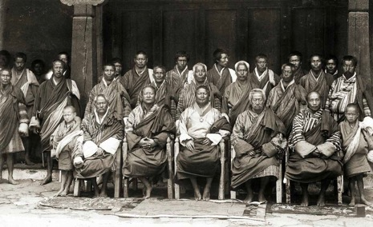
Bhutan!
Notes:
Bhutan is the focus country for the lesson!

Slide 8
Lesson 6 Evaluating Tourist Packages in LIC’s
Unit 2 – The Environment and Tourism

Slide 9
Learning Objective:
To evaluate a tourist package for its environmental, economic and social effects.
Learning Outcomes:
Locate Bhutan and describe some of its natural geography.
Investigate places in Bhutan that you would like to visit.
Analyse the features of tourist resorts in Bhutan.
Evalute the environmental, cultural and economic effects of tourism in Bhutan.

Slide 10
Locating Bhutan
Task 1.
Read the Bhutan country profile and annotate your map of Bhutan with details about its location, the country's geography, people, economy and government.
Include some of its recent achievements and the challenges it faces.
Notes:
Lesson 6 Bhutan Map

Slide 11
Tourism in Bhutan
Task 2. Research…
THREE places you might like to visit
TWO activities you might like to do
ONE thing you would like to learn more about.
Use these websites to start your investigation:
Kingdom of Bhutan
Lonely Planet – Introducing Bhutan
Tourism Council of Bhutan
Wikipedia – Tourism in Bhutan
Wikitravel – Bhutan

Slide 12
Resort Investigation
Task 3.
Use the links below to select a holiday in Bhutan:
Tourism Council of Bhutan
Kingdom of Bhutan
Describe:
What is the focus of the holiday? (place, level of activity, interaction with local people/culture)
What are the geographical, environmental and/or cultural heritage features of the place?

Slide 13
Resort Investigation
Present your findings in whatever format you wish.
Task 3.
In groups of three, investigate your chosen resort using the following questions:
Culture:
What tours are available to deepen understanding about Bhutanese culture?
How do tours engage with Bhutanese culture so that stereotypes are not reinforced and misunderstandings are addressed?
What dos and don'ts should tourists be aware of?
Environment:
What natural attractions can tourists see in Bhutan?
What adventure- and nature-based tourism is available?
How do tours try to limit their effect on the environment?
Economy:
How do tourists contribute to the economy of Bhutan?
How is the income from tourism used to assist rural development?
How does targeting high-value tourists assist the economy?

Slide 14
What’s Your Opinion?
Task 4.
Form an opinion about the balance of positive and negative effects of tourism for Bhutan.
Discuss with a partner who has the opposite point of view:
How can tourism contribute to sustainable development?
What are the best forms of tourism for Bhutan?
How might tourism in Bhutan be developed so that it balances the various perspectives of local communities, tourists, economy and environment?

Slide 15
Issues to consider:
Review
Social/cultural control
of women
Gender role socialisation
Ways men control women
Women and the home
Judgements by men
Women and employment
Relationship rules
Public spaces
Stereotypes
Parental expectations
Role models
How women behave and why
Relationships
Media images

Slide 16
Assignment 2.4 | Natural Tourism Businesses
Task Description:
You will create a tourism business connected to the natural environment at a destination of your choice and present this business through a PowerPoint presentation to the rest of the class.
See Assignment document for more details.
Notes:
Assignment 2.4

