Slide 1
Notes for Presentation
I include this on slides where I would like my students to write
down the information into their notes. Use this at your discretion.
Class/paired/individual task Tasks for students are denoted in blue.
Class Brainstorm Class discussion tasks are denoted in green
Personalized information Information that is personal to my class/local area are denoted in purple and will need amending.
Key Words Key words pertinent to the course are denoted in red.
Notes Section Under each slide prompts for resource files needed for particular tasks, and any other additional information for the teacher will be given.

Slide 2
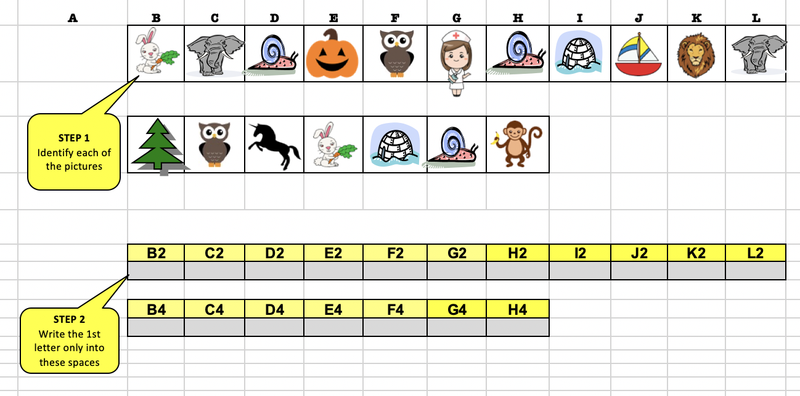
Starter… Crack the Code!
Crack the code to work out the focus for the lesson…
Notes:
Responsible Tourism

Slide 3
Lesson 5 Responsible Tourism
Unit 2 – The Environment and Tourism

Slide 4
Learning Objective:
To examine different approaches to improving the positive and limiting the negative effects of tourism.
Learning Outcomes:
Define responsible tourism.
Explain what it means to be a responsible tourist.
Analyse guidelines about limiting the negative effects of tourism.
Create a statement about responsible tourism and sustainable development.

Slide 5
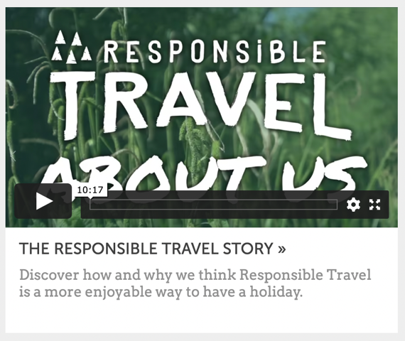
Responsible Tourism
Task 1.
View the video What is responsible tourism? from the Responsible Travel website.
Record your responses to the following questions.
Who created the video?
What message does it present?
What values, lifestyles and points of view are represented in, or omitted from, the message?
How has the message been created?
Who might the message appeal to?
Notes:
Discuss responses with the class.

Slide 6
Responsible Tourism
Responsible tourism…
Minimises negative economic, environmental, and social impacts;
Generates greater economic benefits for local people and enhances the well-being of host communities, improves working conditions and access to the industry;
Involves local people in decisions that affect their lives and life chances;
Makes positive contributions to the conservation of natural and cultural heritage, to the maintenance of the world's diversity;
Provides more enjoyable experiences for tourists through more meaningful connections with local people, and a greater understanding of local cultural, social and environmental issues;
Provides access for physically challenged people;
Is culturally sensitive, engenders respect between tourists and hosts, and builds local pride and confidence.

Slide 7
Responsible Tourism | Jigsaw Task
Task 2.
In groups of 6, research the guidelines about limiting the negative effects of tourism on communities, economy and the environment, each using one of the following websites.
Center for Sustainable Destinations – About geotourism
Ethical Traveler
Responsible Travel
Travel Forever – Sustainable tourism
Tourism Concern – What is community tourism?
World Heritage Centre – World heritage and sustainable tourism programme

Slide 8
Responsible Tourism | Jigsaw Task
Task 3.
Once you have researched your website, discuss your findings with the rest of your group members.
Record your findings in a table/graphic organiser or mind-map.

Slide 9
Responsible Tourism
Task 4.
As a class, discuss the important elements of the approaches that you have just researched.
Create a statement about responsible tourism and sustainable development.
Notes:
Discuss findings from the previous task with the class and create a joint statement.

Slide 10
Review: Time for TED…

Slide 11
Review: Time for TED…
Watch this TEDEd, and answer the questions below:
https://www.ted.com/talks/sumesh_mangalasseri_sustainable_tourism_a_modern_eco_friendly_perspective_on_tourism
How does Sumesh Mangalasseri suggest that tourism can be more sustainable?

