Slide 1
Notes for Presentation
I include this on slides where I would like my students to write
down the information into their notes. Use this at your discretion.
Class/paired/individual task Tasks for students are denoted in blue.
Class Brainstorm Class discussion tasks are denoted in green
Personalized information Information that is personal to my class/local area are denoted in purple and will need amending.
Key Words Key words pertinent to the course are denoted in red.
Notes Section Under each slide prompts for resource files needed for particular tasks, and any other additional information for the teacher will be given.

Slide 2
Starter… Crack the Code!
What do these letters stand for?
Prize for whoever is the first to correctly guess without cheating!!
Notes:
[United Nations Educational, Scientific and Cultural Organization]

Slide 3
Lesson 4 Protecting Natural Environments
Unit 2 – The Environment and Tourism

Slide 4
Learning Objective:
To examine how UNESCO protect natural environments.
Learning Outcomes:
Describe what UNESCO is and what they do with respect to the travel and tourism industry.
Explain what a Biosphere Reserve is and the benefits of designating spaces as such.
Explain what a World Heritage Site is and the benefits of designating spaces as such.

Slide 5
How can we Protect our Natural Spaces?
Class Discussion: How can we protect our natural spaces?
Notes:
Discuss responses with the class.

Slide 6
UNESCO [United Nations Educational, Scientific and Cultural Organization]
Task 1.
Watch this video.
Write down who UNESCO are and what they seek to do.

Slide 7
UNESCO [United Nations Educational, Scientific and Cultural Organization]
What is UNESCO?
UNESCO is the United Nations Educational, Scientific and Cultural Organization. It seeks to build peace through international cooperation in Education, the Sciences and Culture. UNESCO's programmes contribute to the achievement of the Sustainable Development Goals defined in Agenda 2030, adopted by the UN General Assembly in 2015.

Slide 8
UNESCO [United Nations Educational, Scientific and Cultural Organization]
What is their Vision? UNESCO…
Develops educational tools to help people live as global citizens free of hate and intolerance.
Works so that each child and citizen has access to quality education.
Promotes cultural heritage and the equal dignity of all cultures,
Strengthens bonds among nations.
Fosters scientific programmes and policies as platforms for development and cooperation.
Stands up for freedom of expression, as a fundamental right and a key condition for democracy and development.
Helps countries adopt international standards and manages programmes that foster the free flow of ideas and knowledge sharing.

Slide 9
UNESCO Success Stories

Slide 10
Biosphere Reserves
Biosphere reserves are ‘learning places for sustainable development’.
They are sites for testing interdisciplinary approaches to understanding and managing changes and interactions between social and ecological systems, including conflict prevention and management of biodiversity.
They are places that provide local solutions to global challenges. Biosphere reserves include terrestrial, marine and coastal ecosystems. Each site promotes solutions reconciling the conservation of biodiversity with its sustainable use.

Slide 11
Biosphere Reserves
Biosphere Reserves involve local communities and all interested stakeholders in planning and management.
They integrate three main "functions":
1. Conservation of biodiversity and cultural diversity
2. Economic development that is socio-culturally and environmentally sustainable
3. Logistic support, underpinning development through research, monitoring, education and training
These three functions are pursued through the Biosphere Reserves' three main zones…

Slide 12
Biosphere Reserves
Core Areas
It comprises a strictly protected zone that contributes to the conservation of landscapes, ecosystems, species and genetic variation

Slide 13
Biosphere Reserves
Buffer Zones
It surrounds or adjoins the core area(s), and is used for activities compatible with sound ecological practices that can reinforce scientific research, monitoring, training and education.

Slide 14
Biosphere Reserves
Transition Area
The transition area is where communities foster socio-culturally and ecologically sustainable economic and human activities.

Slide 15
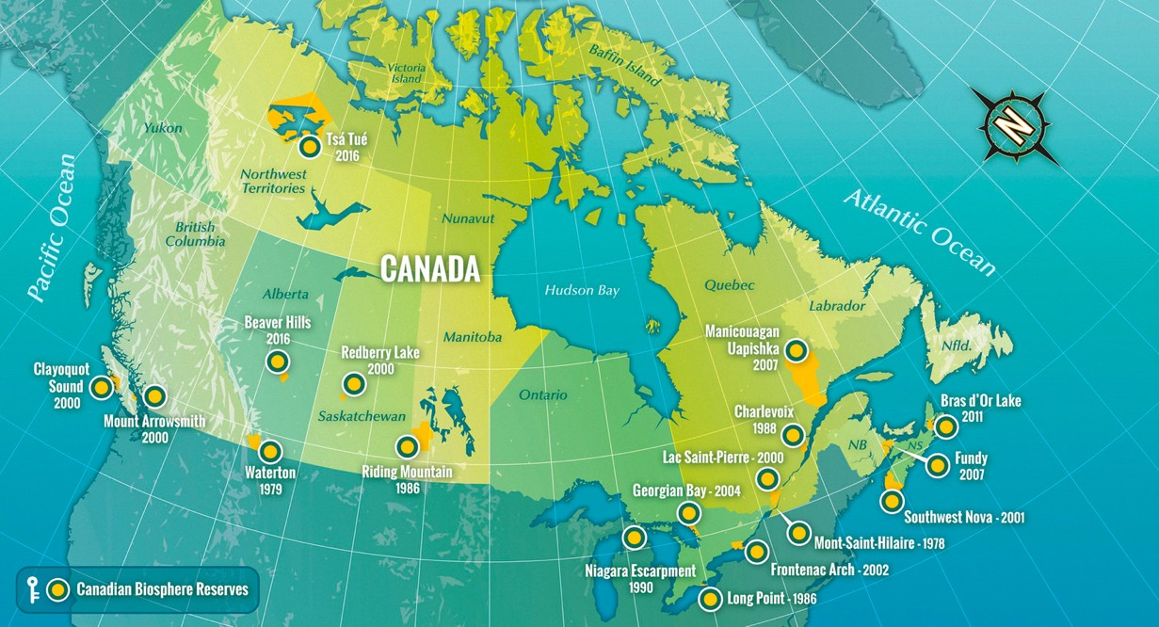
Task 2.
Choose 3 of Canada’s UNESCO Biosphere Reserves as per the map.
Research the three sites using the Biosphere Canada website.
Explain what these sites do and why they were designated Biosphere Status.

Slide 16
World Heritage Sites
Task 3. Investigate the UNESCO criteria list for World Heritage Sites.
A World Heritage Site is a landmark or area with legal protection by an international convention administered by UNESCO.
They must have a cultural, historical, scientific or other form of significance.
The sites are judged to contain "cultural and natural heritage around the world considered to be of outstanding value to humanity".
To be selected, a World Heritage Site must be a somehow unique landmark which is geographically and historically identifiable and has special cultural or physical significance.

Slide 17
Task 4.
Choose 3 of Canada’s UNESCO World Heritage sites as per the map.
Research the three sites using the UNESCO website.
Evaluate and explain how these sites meet the UNESCO World Heritage criteria.

Slide 18
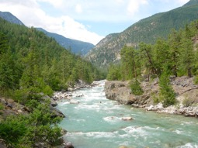
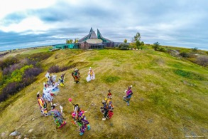
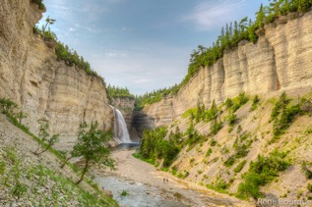
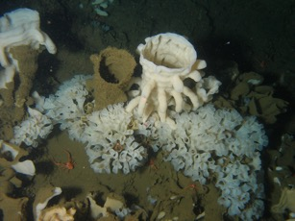
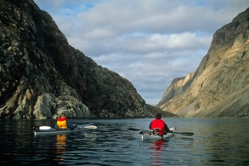
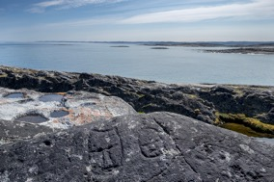
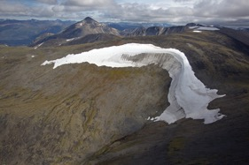
Review:
Read about these 8 potential Canadian World Heritage Sites.
Which one would you choose and why?
How could the designation of such a site help to promote tourism in the area?

Slide 19
Assignment 2.3 | UNESCO Protected Spaces
Task Description:
Create a presentation describing a UNESCO World Heritage Site and a World Biosphere Reserve. Both sites should be in (relatively) close proximity to a location on your bucket list.
See Assignment document for more details.
Notes:
Assignment 2.3

