Slide 1
Notes for Presentation
I include this on slides where I would like my students to write
down the information into their notes. Use this at your discretion.
Class/paired/individual task Tasks for students are denoted in blue.
Class Brainstorm Class discussion tasks are denoted in green
Personalized information Information that is personal to my class/local area are denoted in purple and will need amending.
Key Words Key words pertinent to the course are denoted in red.
Notes Section Under each slide prompts for resource files needed for particular tasks, and any other additional information for the teacher will be given.

Slide 2
Starter… Tourism Word Cloud.
Using www.wordart.com create a word cloud for the word ‘tourism.’

Slide 3
Lesson 1 Introduction to Tourism
Unit I – Perspectives of Travel and Tourism

Slide 4
Learning Objective:
To have an introduction to travel and tourism.
Learning Outcomes:
Describe different perspectives of studying travel and tourism.
List and describe factors that motivate people to travel.
List and describe barriers that prevent people from travelling.
Learn to use Google my Maps by creating a map of the places you have travelled to.

Slide 5
What is this course about?
Class Task: Watch this video and Describe or identify the locations in this video you would like to visit. Which of the activities are the most appealing to you? Are there any that you would never consider visiting?
Tourism Video

Slide 6
What is Tourism?
Task 1: Write down a ONE sentence definition of tourism.

Slide 7
What is Tourism?
“Tourism is travel for pleasure or business; also the theory and practice of touring, the business of attracting, accommodating, and entertaining tourists, and the business of operating tours.”

Slide 8
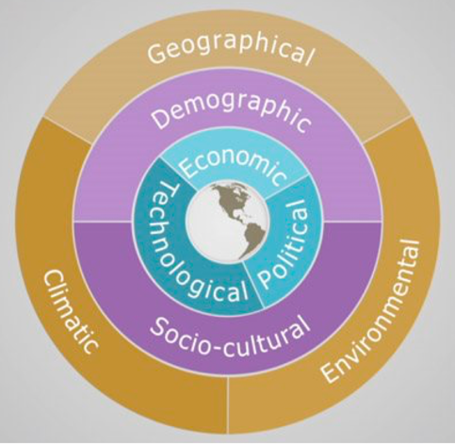
Perspectives of Travel and Tourism
Factors that determine where people choose to travel
Reasons a location makes a good tourism destination
Factors that determine if people are able to travel
Reasons why and where people choose to travel

Slide 9
Why do People Travel?
Task 2. In pairs, brainstorm the top 10 reasons why you think people are motivated to travel.

Slide 10
Why do People Travel?
To get a new perspective
There’s nothing like travel to help you see that what you think is “the way people do things” is really just the way YOU do things. From our families to our work to our food to our homes, humankind is alive with differences you cannot imagine—until you see them for yourself.
2. To see the world through new eyes “We need sometimes to escape into open solitudes, into aimlessness, into the moral holiday of running some pure hazard, in order to sharpen the edge of life, to taste hardship, and to be compelled to work desperately for a moment at no matter what,” wrote philosopher George Santayana in “The Philosophy of Travel.”

Slide 11
Why do People Travel?
3. To gain appreciation for what you have There’s no place like home—but that’s so easy to forget. Leaving the comforts behind gives you a renewed appreciation for them when you return.
4. To get some distance from work Americans have a reputation the world over have for being unable to leave their jobs behind. But taking a step away from the job is good for your physical and mental health. It’s good for your work, too— it gives you the space to see the big picture in a new way, and builds a stronger team by forcing you to delegate and let someone else have your back.

Slide 12
Why do People Travel?
5. To settle grievances through shared experiences There’s nothing like a glass of wine by the cruise-ship pool to open a discussion that helps you see another person’s side of things. Family grudges and hurt feelings that rumble beneath the surface of the annual Thanksgiving dinner look different when you’re making memories and sharing pleasurable experiences—and seeing each other, literally, in a new light.
6. To get you out of your comfort zone Whether you’re stuck in a rut or looking to gain a little independence, traveling can teach you things you never knew about yourself. Discover your resourcefulness while mingling with the locals. Realize your capabilities while navigating your way through a foreign city. You’ll never learn more about yourself than when you travel.

Slide 13
Why do People Travel?
7. To admire Mother Nature Travel gives us the gift of seeing how small we really are in comparison to the beauty of Mother Nature. From crystal blue waters to pink sands to lush greenery, the real world is full of colors and sounds, sights and sites, that no computer screen can duplicate.
8. To learn about other cultures Every destination has its own unique history and style. A passionate local tour guide will immerse you in a world that’s completely different from the one in which you live.

Slide 14
Why do People Travel?
9. To strengthen relationships There’s something about the shared experience of travel that can bring people together. Family vacations, a trip with a significant other, or a girls’ weekend will build a lifelong bond.
10. To unplug We’re constantly checking in on our phones, living life through other’s status updates or posts. Traveling allows you to disconnect from emails and social media. Sit back, relax, and take in the moment without the screen of your phone blocking the view.
Check out this website which describes over 50 reasons why people like to travel!!!

Slide 15
Why do People Travel?
Task 3. Personal travel motivators change through time. List the main reasons you would travel at this point in your life.
Then think about your future and identify the travel motivators that will:
Decrease in importance as you age
Increase in importance as you age
Remain important to you throughout your life.

Slide 16
What Stops People From Travelling?
Task 4. In pairs, brainstorm all the barriers that prevent people from travelling.

Slide 17
What are the Barriers to Travelling?
1. Cost: Consumers have budgets. Travel competes with other financial commitments.
2. Health: Inadequate health may keep people from travelling.
3. Time: People have jobs, business, family, and other commitments that limit the time available for travel.
4. Family stage: Parents with young children may limit travel because of cost and inconvenience or may be restricted in their choice of travel destination.
5. Lack of interest: people have values and other interests that may screen out travel.
6. Fear: Knowledge of political conflict or high crime rates at destinations may deter travellers.
7. Language: When travelling language barriers are really important as you are unable to problem solve.

Slide 18
What are the Barriers to Travelling?
The Language Barrier!
Read this article about the Iconspeak T-Shirt!
Class Discussion: What are your thought?

Slide 19
What Stops People From Travelling?
Task 5. Identify the travel barrier influencing each of the following decisions:
The McCrindles have switched their vacation from Cancun to a northern Ontario resort because they have read about recent increases in crime against tourists in Mexico.
Ms. Vass has to complete a business proposal and cannot take the planned weekend trip to Toronto.
The Hendrens will postpone their vacation because of the recent birth of little Manny Hendren.
Notes:
Change words in purple to suit those in your class!

Slide 20
What Stops People From Travelling?
Task 5. Identify the travel barrier influencing each of the following decisions:
Sam has twisted her ankle playing on the school basketball team. She will not be able to go on the ski trip planned to Blue Mountain this month.
Mark has been given a choice by his parents. He can either travel on the school trip to New York City or he can buy a new mountain bike. He will not be able to do both.
Julie has turned down the opportunity to go on a camping trip to Algonquin Park. She said she preferred not to miss a local soccer tournament planned for the same weekend.

Slide 21
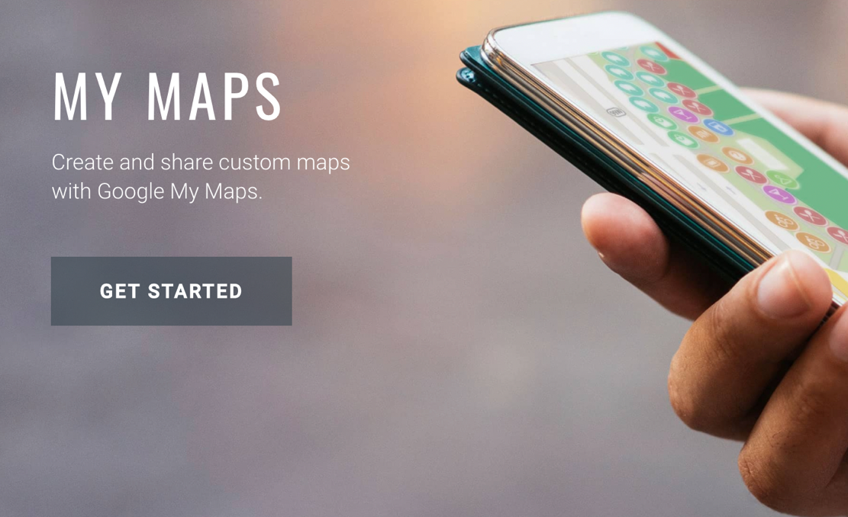
Travel and Tourism Map
Task 6. We will be using Google My Maps in many assignments this semester. For this initial task, create a map which lists all of the places you’ve travelled to. Use icons to help communicate the types of place that you have visited.
Notes:
https://www.google.ca/maps/about/mymaps/

Slide 22
Review:
5 – Barriers to travel
4 – Motivations to travel
3 – Locations you would like to travel to
2 – Perspectives of travel and tourism
1 – Definition of tourism

