Slide 1
Assignment 1.1
Decision Making Exercise

Slide 2
Ranking on a continuum
You are going to identify and then rank the factors affecting the location decisions of particular businesses in order of importance.
You will do this by placing each factor on a scale from ‘most important’ to ‘least important’.
Each person will be given TWO situations.
You will need to explain your reasoning afterwards in the form of a report

Slide 3
Students and Situations
Student Name
Situation 1 (Supermarket Chain)
Situation 2 (Electrical Appliances)
Student Name
Situation 3 (Technology Firm)
Situation 4 (Fashion Industry)
Student Name
Situation 5 (Telecommunications Company)
Situation 6 (Bakery)

Slide 4
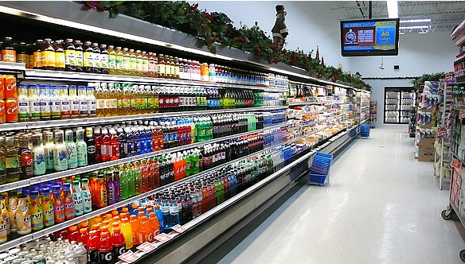
Situation 1
A large supermarket chain wants to enter the Indian retail market. Its superstores sell a wide variety of imported and locally produced food products as well as houseware and electrical goods, such as microwaves and TVs.

Slide 5
Situation 2
A manufacturer of electrical appliances is currently producing household fridges and freezers in Thailand. However, an increase in the national minimum wage has made it more expensive to produce its products there. It is considering whether to move production to another country.

Slide 6
Situation 3
An information technology firm that specialises in providing ‘cloud’ computing services to business is looking for a location to build a new data storage centre. The new facility will store important information for domestic and international clients.

Slide 7
Situation 4
A leading international clothing label wishes to open a flagship (leading) retail outlet on Orchard Road in Singapore (famous for shopping). It is hoped that the store will attract plenty of customers and help to promote its brand and latest designs.

Slide 8
Situation 5
A telecommunications company is looking for a suitable place to locate its international customer helpline call centre.

Slide 9
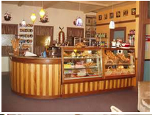
Situation 6
A bakery that specialises in making fresh bread is expanding and requires larger premises. The company will use the new premises to produce and package its bread. The bread will then be delivered to various stores and supermarkets throughout the local area where it will be sold to customers.

