Slide 1
The Danger of a Single Story - Privilege
23 November 2020

Slide 2
Learning Objectives (BC Curriculum)
Identify periods of progress and decline, and identify key turning points that marked periods of continuity or change
Assess the significance of people, places, events, or developments at particular times and places
Understand the concept of privilege and how it applies to media.
Reflect upon own experiences of privilege.

Slide 3
Option #1. Privilege Walk
Activity Instructions
Privilege Walk Video
Notes:
Grades 8-10
Option 1. Either play the walk with the class or you can watch the video instead. Then debrief using the questions on the instructions sheet.

Slide 4
Option #2. Privilege Basket Game
Activity Instructions
Notes:
Grades 6-8
This is a different activity which could be played with younger grades.

Slide 5
What is Privilege?
Privilege refers to the advantages that come from being part of the dominant group in society.
This can be dangerous because it helps to promote a single story.
Notes:
Discussion?
https://www.sprc.org/scope/racial-ethnic-disparities
Give your own examples of privilege as you see fit for your class.

Slide 6
What is Privilege?
When we think of racism and discrimination, we often think about deliberate acts towards a disadvantaged group - hurtful words, tasteless jokes, exclusion from work or school, and so on. But it can easily take the form of advantages given to members of a more advantaged group.
Unlike those forms of discrimination, these advantages may go unnoticed by members of an advantaged group.

Slide 7
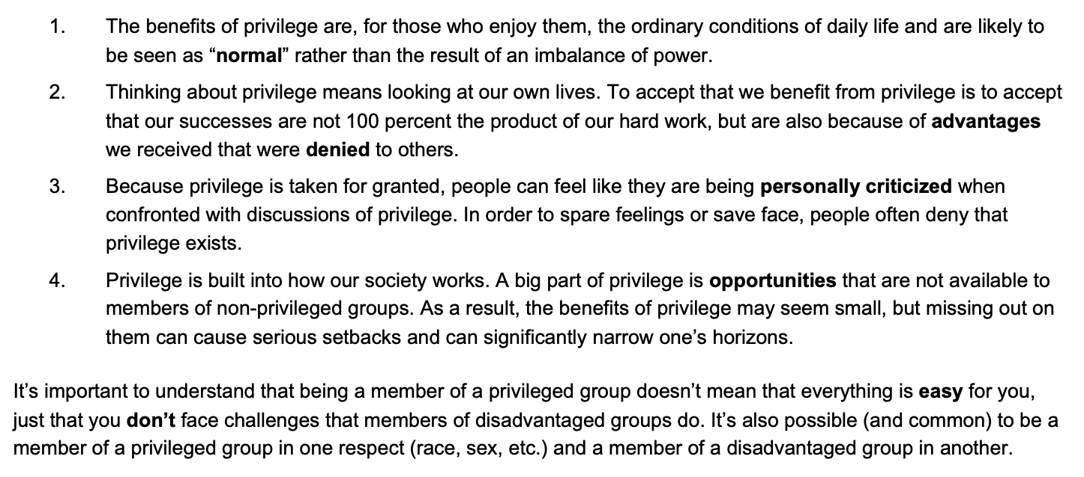
Privilege in our Lives

Slide 8
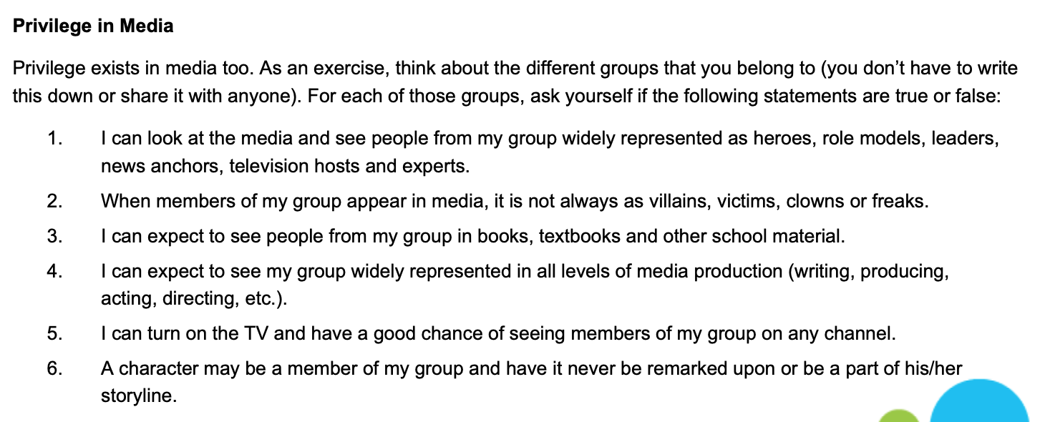
Privilege in the Media

Slide 9
Privilege in the Media

Slide 10
Taking Action: What can we do?
We can’t get rid of our privileges on our own., but we can become more aware of them and work to change the systems that privilege some groups and disadvantage others.
What do you think we can do?
Notes:
Brainstorm ideas with the class

Slide 11
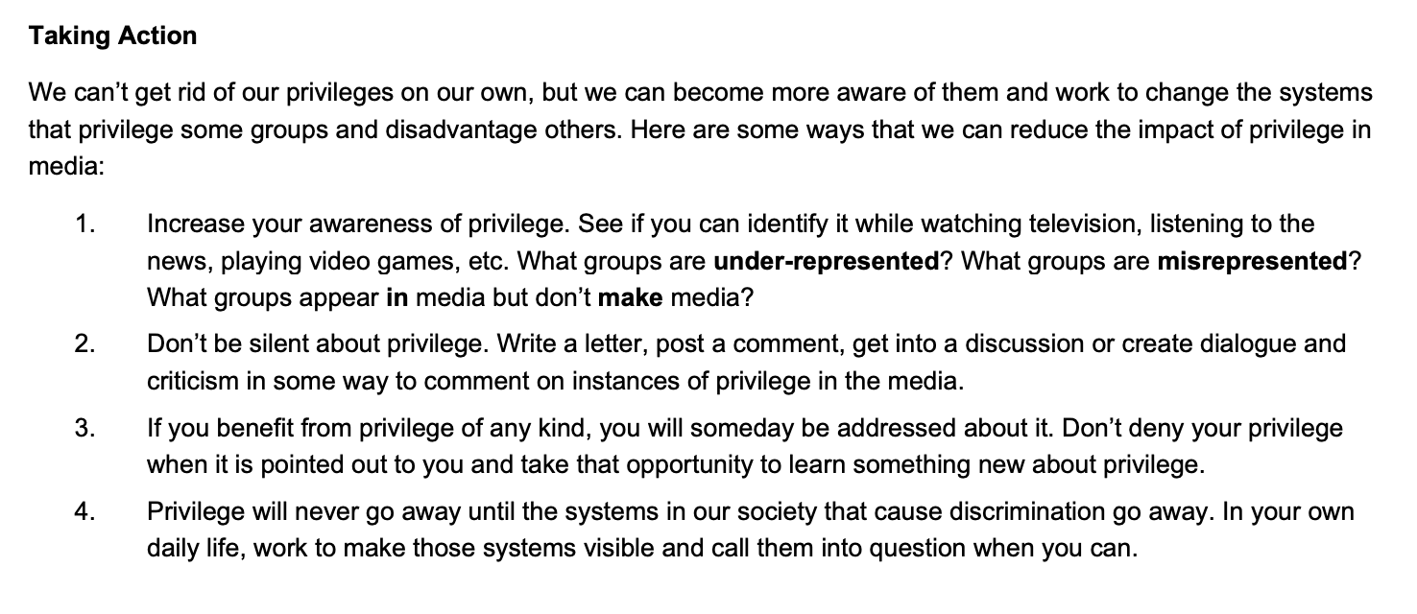
Taking Action: What can we do?
Notes:
Brainstorm ideas with the class

Slide 12
Exit Card
List one thing that you learned today about privilege.
What are two things that you found out makes you privileged?
Starting today, how can you raise awareness about privilege with your friends and/or family?
How did the lesson impact you? What emotions did you experience/feel?

