Slide 2
Learning Objectives
What is Pink Shirt Day?

Slide 3
Learning Objectives
Bullying is a major problem in our schools, workplaces, homes, and online. Over the month of February, and throughout the year, CKNW Kids' Fund's Pink Shirt Day aims to raise awareness of these issues, as well as raise funds to support programs that foster children’s healthy self-esteem.

Slide 4
Learning Objectives
Now a movement celebrated across the globe, Pink Shirt Day has humble beginnings. Inspired by an act of kindness in small-town Nova Scotia, CKNW Kids' Fund, working with partners Boys & Girls Clubs and 980 CKNW, was inspired to raise funds to support anti-bullying programs.

Slide 5
Learning Objectives
What is Bullying?

Slide 6
Learning Objectives
Bullying is a form of aggression where there is a power imbalance; the person doing the bullying has power over the person being victimized. In additional to any physical trauma incurred, bullying can result in serious emotional problems, including anxiety, low self-esteem, or depression.

Slide 7
Learning Objectives
Types of Bullying

Slide 8
Learning Objectives
Physical bullying: using physical force or aggression against another person (e.g., hitting)
Verbal bullying: using words to verbally attack someone (e.g., name-calling)
Social/relational bullying: trying to hurt someone through excluding them, spreading rumours or ignoring them (e.g., gossiping)
Cyberbullying: using electronic media to threaten, embarrass, intimidate, or exclude someone, or to damage their reputation (e.g., sending threatening text messages).

Slide 9
Learning Objectives
#1. Is it Bullying?
Notes:
Option 1 - Is it bullying?

Slide 10
Learning Objectives
Split into groups of 2-3.
Split the poster paper into 3 columns - write the term ‘Bullying’ across the top of one column and ‘Not bullying’ on the second, write 'Depends' on the third column.
You are going to be given a number of pieces of paper that have different situations on them. In their groups they will have to decide whether or not the situations are examples of bullying or not and place them in the appropriate column.
Spend some time exploring each of the statements and their reasons for where the situations are placed.
Swap with another group so you can have a look through each other’s statements and discuss if you agree with where they have been placed.
What were your reasons for placing the statements where you did?
Notes:
Bullying statements

Slide 11
Learning Objectives
#2. What Makes a Healthy School Environment?
Notes:
Option 3

Slide 12
Learning Objectives
Close your eyes for one minute and visualize a healthy school environment.
Focus on what you see, what you hear and what you feel.
Open your eyes and choose a partner.
Share with your partner what you thought about during the visualization.
Go over to the SEE, HEAR, FEEL titles and write down your responses under the appropriate title.
Notes:
Prepare three pieces of paper with one of the following titles: HEAR, SEE and FEEL. Post on the wall in the classroom.

Slide 13
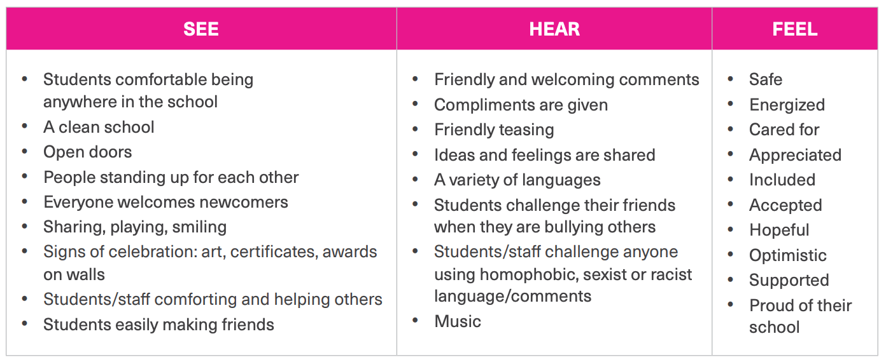
Learning Objectives
Notes:
Sample responses

Slide 14
Learning Objectives
A positive school environment is a place where people treat each other well and have healthy relationships.
It’s having respect for everyone, not just your friends.
I challenge you to commit yourselves to a task to maintain a healthy, positive school environment all year long.
Notes:
Sample responses

Slide 15
Learning Objectives
#3. Actions to create healthier youth relationships!
Notes:
Option 4

Slide 16
Learning Objectives
“Healthy relationships and healthy schools and communities only happen when we work together. It’s our actions—both big and small—that can make a difference.”
“These actions are called social action. Social action is working with others to bring about change.”

Slide 17
Learning Objectives
Watch these videos that are examples of social action.
• Buddy Bench
• To This Day
Notes:
Feel free to choose your own.

Slide 18
Learning Objectives
There are many ways we can take action on issues that matter to us in our lives. We could volunteer, wear a T-shirt that supports a cause, or make a music video to send a message. We just have to decide what to do, make a plan, and do it!
We have had many important social movements happen in Canada that were driven by everyday people and these movements changed our world. Many of them have promoted human rights and equality.

Slide 19
Learning Objectives
Activity:
Get into groups of three.
Brainstorm actions you could take to address one of the questions posed on the following slides.

Slide 20
Learning Objectives
How could you raise awareness about the right to protection from violence and the right to be treated fairly and equally with respect to your gender, race, religion, age, or abilities?
How do we let people know that bullying is not cool and that it has negative impacts that can last for a long time?
How could you promote the qualities of a healthy relationship – respect, trust, safety, communication?
How do we celebrate diversity to build safe and inclusive schools and communities?
Notes:
Discuss responses with class.

Slide 21
Learning Objectives
5. How can we let people know that sexual harassment is not a
joke and that we always have to consider the impact of our
words and actions?
6. How do we stand up and send a message that LGBTQ2S
students are entitled to feel safe, respected, and
appreciated?
7. How do we encourage others to step in and do something
around these issues?
Notes:
Discuss responses with class.

Slide 22
Learning Objectives
How could you raise awareness about the right to protection from violence and the right to be treated fairly and equally with respect to your gender, race, religion, age, or abilities?
How do we let people know that bullying is not cool and that it has negative impacts that can last for a long time?
How could you promote the qualities of a healthy relationship – respect, trust, safety, communication?
How do we celebrate diversity to build safe and inclusive schools and communities?
How can we let people know that sexual harassment is not a
joke and that we always have to consider the impact of our
words and actions?
How do we stand up and send a message that LGBTQ2S
students are entitled to feel safe, respected, and
appreciated?
How do we encourage others to step in and do something around these issues?
Notes:
Discuss responses with class.

