Slide 1
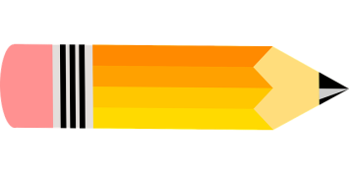
I include this on slides where I would like my students to write
down the information into their notes. Use this at your discretion.
Class/paired/individual task Tasks for students are denoted in blue.
Class Brainstorm Class discussion tasks are denoted in green
Personalized information Information that is personal to my class/local area are denoted in purple and will need amending.
Key Words Key words pertinent to the course are denoted in red.
Notes Section Prompts for resource files needed for particular tasks, and any other additional information for the teacher will be given.

Slide 2
Starter:
Read this infographic about the fishing industry in Nova Scotia…
Does anything surprise/interest you about the numbers?
Notes:
Discuss responses with students

Slide 3
Resources and Industries
Lesson 5. The Canadian Fishing Industry

Slide 4
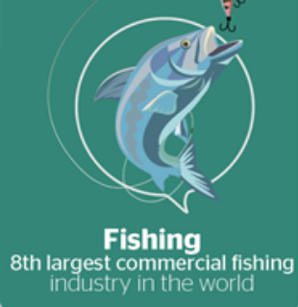
Lesson 5.
The Canadian Fishing Industry
Learning Goals:
Describe different types of fishing industry.
Explain why the Atlantic fishing industry is important for Canada.
Assess the reasons for the collapse of Atlantic fishing.
Explain how we can be more sustainable.

Slide 5
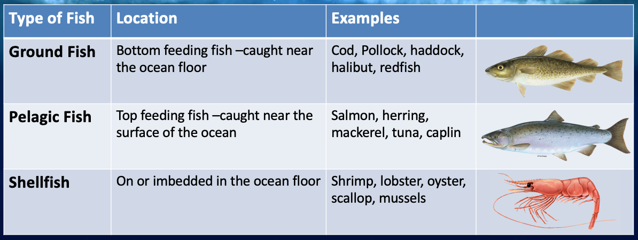
What are we Fishing for?

Slide 6
Fishing Methods
In Shore:
Small boats, limited gear, self-employed
85% of fishers but 10% of fish caught
Day-trips in good weather
Low income
Eg: Lobster, shrimp, clams, cod, haddock.

Slide 7
Fishing Methods
Off Shore:
Large ships, variety of gear, company owned
15% of fishers but 90% of fish caught
Out for 2 weeks or more
Good income
Eg: Cod, sole, halibut, flounder.

Slide 8
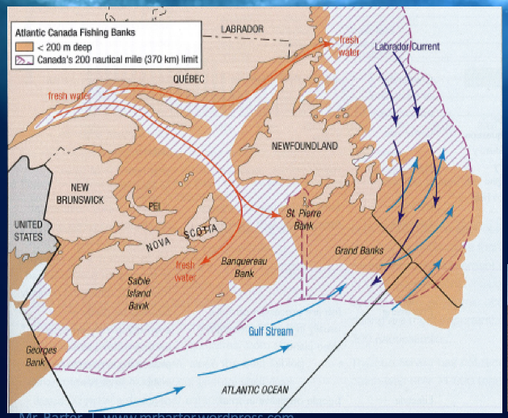
Fishing in Atlantic Canada
The Grand Banks: Ideal fishing grounds
Relatively shallow (100-200m deep)
Mixture of cold Arctic and warm Gulf stream currents
Most of the Grand Banks are within Canada’s border
Ideal habitat for fish such as cod.

Slide 9
Atlantic Fishing: Importance
Today, Canada has one of the world’s biggest fishing economies.
The commercial fishing industry employs 80,000 people and generates nearly $7 billion for the nation in both wild capture and aquaculture fisheries.
Recreational fishing, too, is a major economic force, contributing nearly $9 billion to the Canadian economy each year.

Slide 10
Atlantic Fishing: Issues
But Canada’s recent fishing history has been marked by one of the most famous fishery collapses in modern times. In 1992, the cod population on Canada’s northeast coast collapsed under fierce fishing pressure to less than one percent of its historic high. A 500-year-old industry that supported the colonizing and thriving of Canada as a nation was gone in what seemed like a blink of an eye, though warning signs and partial collapses had been evident for decades. More than 20 years later, northern cod have not returned to healthy levels. It is one of the famous cautionary tales taught to marine resource managers and ocean conservation advocates.

Slide 11
Atlantic Fishing: Issues
Task 1:
Read the Case study: Northwest Atlantic cod fishery article provided.
Create a 5 W’s fact file about the current situation. Ensure that you refer to all 6 pieces of the puzzle explaining why fish stocks declined.
Notes:
Lesson 6 Atlantic Fishing Case study (pages 2-5)

Slide 12
Atlantic Fishing: Issues
Problems:
Overfishing
Catching the wrong fish (by-catch)
High demands for fish and fish products
Lost or broken nets
Unemployment

Slide 13
Atlantic Fishing: Issues
Solutions:
Class Discussion
What are the solutions to these problems?

Slide 14
Atlantic Fishing: Issues
Solutions:
Strictly regulating catch quotas
Better net design
Ensure that only specific fish are caught
Diversify diets and eat sustainably
Aquaculture and fish farms
Proper net disposal and recovery
Retrain for new industries

Slide 15
Sustainable Fishing
The Marine Stewardship Council (MSC)
Watch these two videos and answer the following questions: Video 1 Video 2
What is the MSC?
What do they do?
Why is sustainable fishing important?
What does the MSC label mean?
Notes:
https://www.youtube.com/watch?v=3rVeSBdpO6Q&feature=emb_logo
https://www.youtube.com/watch?v=EhosdSmvWrI

Slide 16
Review: The Future of Fishing
Question: How sustainable is Canada’s seafood?
Answer this question based upon the information in this infographic…

