Slide 1
I include this on slides where I would like my students to write
down the information into their notes. Use this at your discretion.
Class/paired/individual task Tasks for students are denoted in blue.
Class Brainstorm Class discussion tasks are denoted in green
Personalized information Information that is personal to my class/local area are denoted in purple and will need amending.
Key Words Key words pertinent to the course are denoted in red.
Notes Section Prompts for resource files needed for particular tasks, and any other additional information for the teacher will be given.

Slide 2
Starter:
What do we know about earthquakes??

Slide 3
The Physical Environment
Lesson 5. Earthquakes

Slide 4
Lesson 5.
Earthquakes
Learning Goals:
Describe how earthquakes are caused.
Explain how earthquakes are measured.
Explain the differences between body waves and surface waves.

Slide 5
Earthquakes
Each year more than 30,000 earthquakes happen worldwide. Most are minor and do very little damage.
Only about 100 major earthquakes happen each year on the average.
If one of these major earthquakes happens near a city or heavily populated area, the results can be very destructive

Slide 6
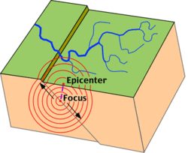
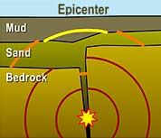
An earthquake is the vibration of Earth produced by the rapid release of energy within the lithosphere.
Earthquakes are produced by slippage along a break in the lithosphere called a fault.
The point within the earth where the earthquake starts is called the focus. The focus of an earthquake is located along a fault underneath the surface.
The point on land where the earthquake does the most damage is directly above the focus. This point is called the epicentre.
The energy released by the earthquake travels in all directions from the focus in the form of seismic waves.

Slide 7
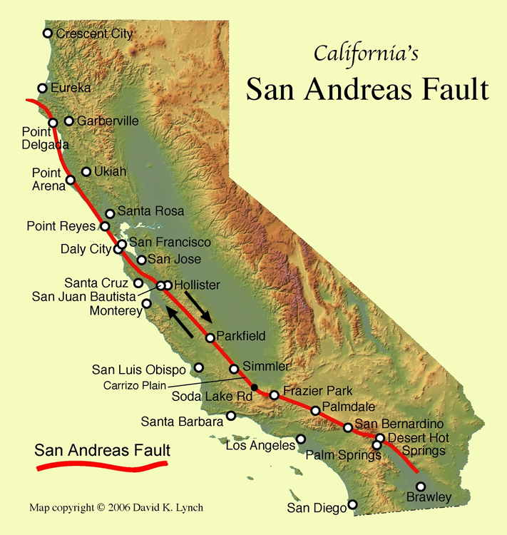
The San Andreas fault:
The San Andreas fault in California is one of the most studied fault systems in the world.
This fault extends about 1300 kilometers through the state and into the Pacific ocean.
Studies have shown that displacement has occurred along the fault in areas as much as 200 kilometers long.

Slide 8
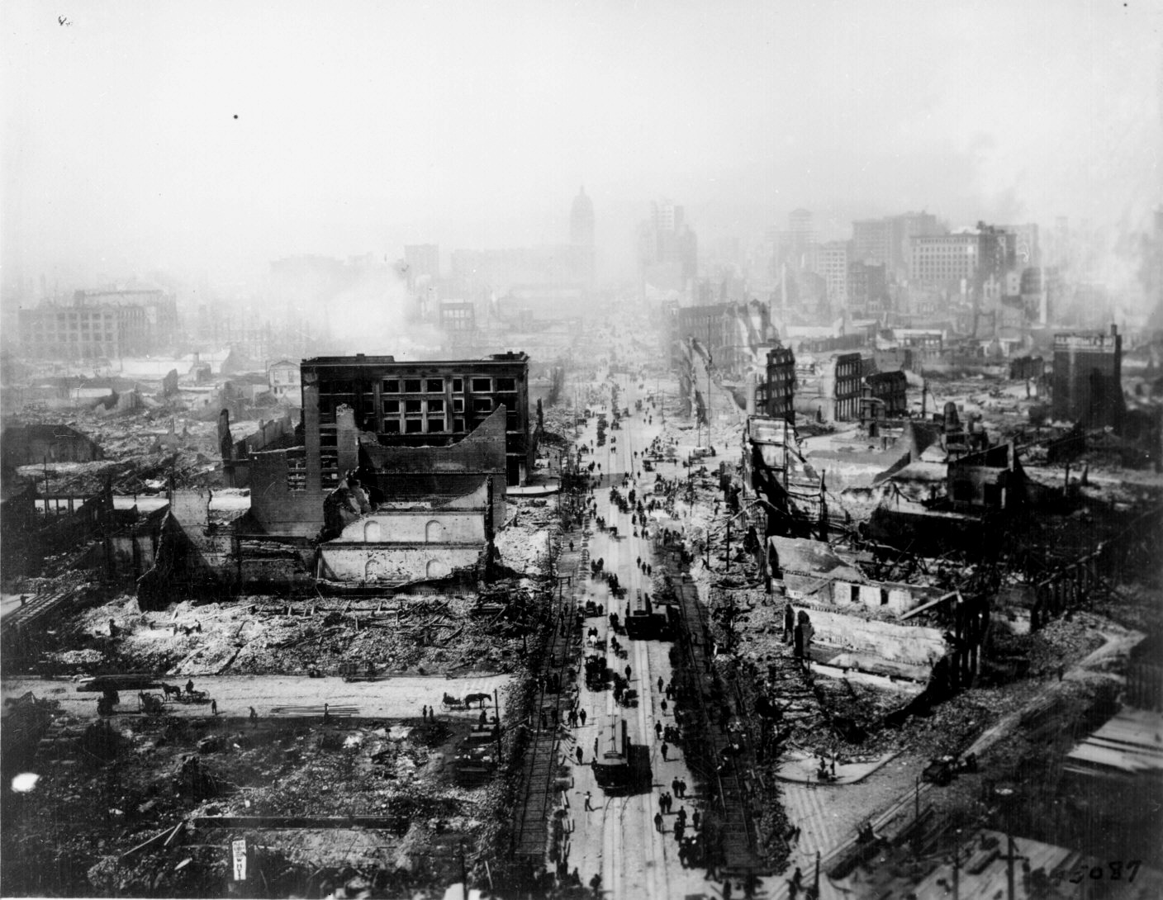
The San Andreas fault:
The San Andreas fault is 1300 kilometers long but segments of it 100 to 200 kilometers long tend to act individually.
Some segments show a slow, gradual slip known as fault creep. Other sections regularly slip and produce small earthquakes.
Some segments remain unmoved for hundreds of years and then move suddenly with explosive force producing large earthquakes.

Slide 9
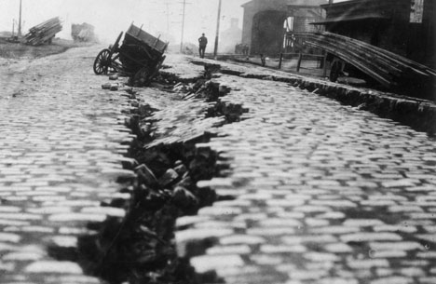
The San Andreas fault:
One great earthquake along the fault was the San Francisco Earthquake of 1906.
During this earthquake, the land on the western side of the fault moved 4.7 meters in relation to the land on the east.

Slide 10
Before the San Francisco Earthquake, scientists did not understand what caused them. Studies afterward led to the development of a hypothesis that explained earthquakes.
According to the elastic rebound theory, most earthquakes are produced by the rapid release of energy stored in rock that has been subjected to great forces.
When the strength of the rock is exceeded, it suddenly breaks, releasing some of it’s energy as seismic waves.

Slide 11
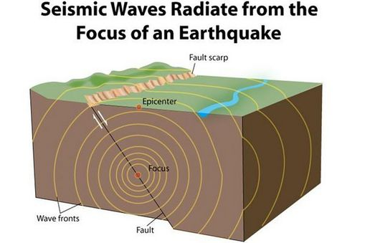
In 2003, a powerful earthquake shook Alaska wilderness south of Fairbanks along the Denali front. This earthquake was so strong it shook ponds in Louisiana and Texas.
Seismic waves carry the energy released from an earthquake hundreds of kilometers away.
Seismic waves transmit the energy of these vibrations from particle
to particle. Like a bell hit with a hammer, the vibrations ring through the rocks the bedrock that makes up the lithosphere.

Slide 12
Earthquakes produce two main types of seismic waves
Body waves
Surface waves
These seismic waves differ in
their type of wave motion,
their behavior as they travel through the Earth,
and their speed.
The waves that travel through the Earth’s interior are called body waves.
There are two types of body waves
P waves
S waves

Slide 13
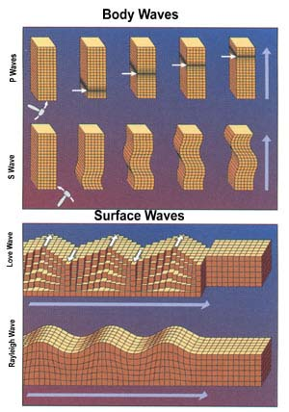
Body Waves:
P waves are push-pull waves that push and pull particles as they move in a direction. They could also be said to compress-expand.
P waves are also called compressional waves. P waves travel faster than S waves. P waves can travel through both liquids and solids.
S waves shake particles at right angles to the waves direction. Like taking one end of a rope and shaking it, the waves move in a curve. S waves are also called transverse waves.
Notes:
Use resource: Lesson 5 Earthquakes worksheet for Slides 13-15

Slide 14
Surface waves:
When body waves reach the surface, they produce surface waves. Surface waves travel more slowly than body waves do.
Surface waves move up and down as well as side-to-side.
Surface waves are usually much larger than body waves, so surface waves are usually the most destructive seismic waves.
1. Love waves
2. Rayleigh Waves

Slide 15
Love Waves:
A Love wave is a surface wave having a horizontal motion that is transverse (or perpendicular) to the direction the wave is traveling.
Rayleigh Waves:
A Rayleigh wave is a seismic surface wave causing the ground to shake in an elliptical motion, with no transverse, or perpendicular, motion.

Slide 16
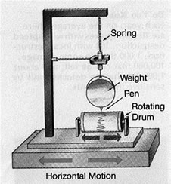
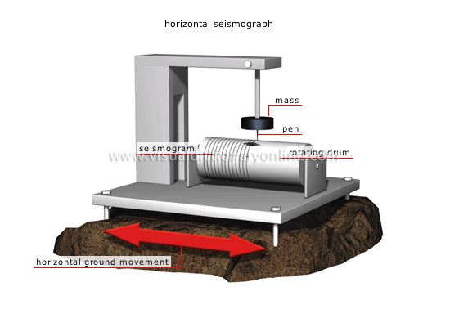
Recording Seismic Waves:
Scientists have developed an instrument to record seismic waves: the seismograph.
A seismograph produces a time record of the ground motion during an earthquake.
How it works: A seismograph has a weight suspended from a support that is attached to the bedrock.
When seismic waves reach the bedrock, the inertia of the suspended weight keeps the weight arm almost stationary while the bedrock moves.
In older seismographs, a pen suspended drew on a rotating cylinder and the traces showed the movement of the waves.

Slide 17
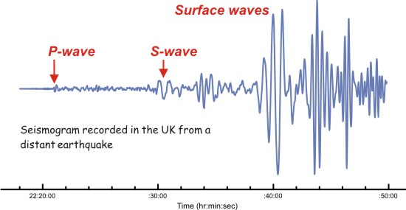
Seismogram:
The time record that a seismograph produces is called a seismogram.
A seismogram shows all three types of seismic waves.
The stronger the earthquake, the larger the waves on the seismogram.
The first wave to arrive is the P wave, followed soon after by the S wave.
After the S waves, the Surface waves arrive showing much stronger movement.

Slide 18
Intensity is a measure of the amount of earth shaking that happens at a given location in an earthquake.
Magnitude (M) is a measure of the size of the seismic waves or the amount of energy released at the source of the earthquake.
The Richter Scale measures earthquake’s magnitude.
The Modified Mercalli Scale is based on earthquake intensity.

Slide 19
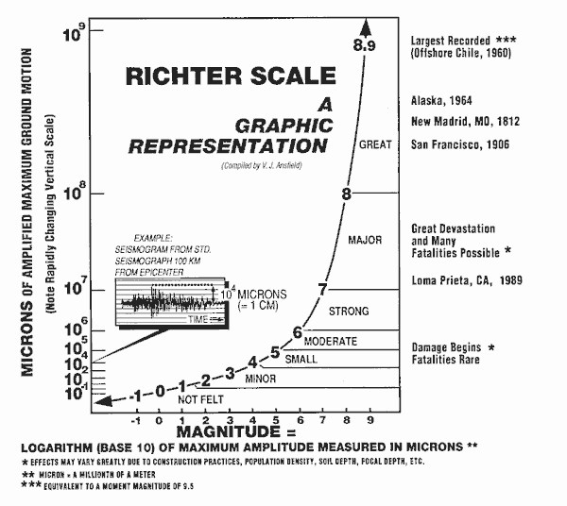
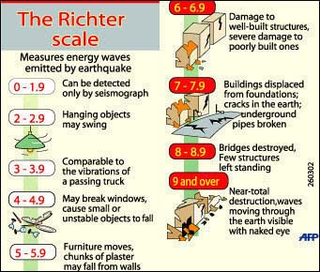
Richter Scale:
A familiar but outdated scale for measuring the magnitude of earthquakes is the Richter Scale.
The Richter Scale is based on the height of the largest seismic wave (P,S, or surface wave) recorded on a seismograph.
A 10X increase in wave height equals an increase of 1 on the Richter Scale.
An increase for a M5.0 earthquake is 10 times greater than the shaking produced by a magnitude 4.0 on the Richter Scale.

Slide 20
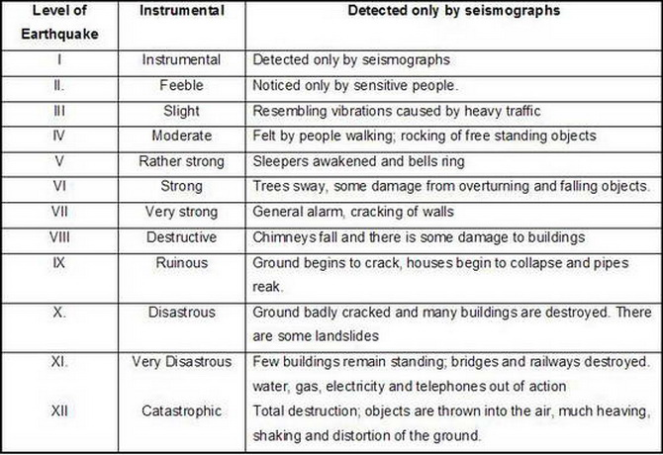
Modified Mercalli Scale:
Another scale used to rate earthquakes is the modified Mercalli scale.
This scale rates an earthquake’s intensity in terms of an earthquake’s effects at different locations (how much shaking it creates or damage it does).
The scale has 12 steps expressed as Roman numerals An earthquake that is barely felt rates a I. An earthquake which creates almost total destruction rates a XII
The same earthquake can rate different Mercalli scale ratings at different locations.

Slide 21
Review:
Key terms dominoes!!
Key terms bingo!!
Notes:
Use next slide.

Slide 22
Review: Earthquake Vocabulary
Focus: the point beneath Earth's surface where rock that is under stress breaks Epicenter: point directly above the focus on the earths surface Seismic waves: vibrations that travel through Earth's surface carrying energy Primary waves: the earthquake waves that compress and expand the ground like an accordion Secondary waves: the waves that vibrate from side to side as well as up and down Surface waves: when Primary waves and Secondary waves reach the surface some of them are transformed into Surface waves Seismograph: instrument that geologist use to record and measure the vibration of seismic wave Magnitude: the measurement of earthquake strength based on seismic waves Mercalli Scale: rate earthquakes by their intensity Richter Scale: rate earthquakes by mechanical seismograph Moment Magnitude Scale: rates earthquakes by estimating the total energy released

