Slide 1
I include this on slides where I would like my students to write
down the information into their notes. Use this at your discretion.
Class/paired/individual task Tasks for students are denoted in blue.
Class Brainstorm Class discussion tasks are denoted in green
Personalized information Information that is personal to my class/local area are denoted in purple and will need amending.
Key Words Key words pertinent to the course are denoted in red.
Notes Section Prompts for resource files needed for particular tasks, and any other additional information for the teacher will be given.

Slide 2
Starter:
What do you see?
Can you see the 3D images in the next picture?
Notes:
Discuss with class.

Slide 4
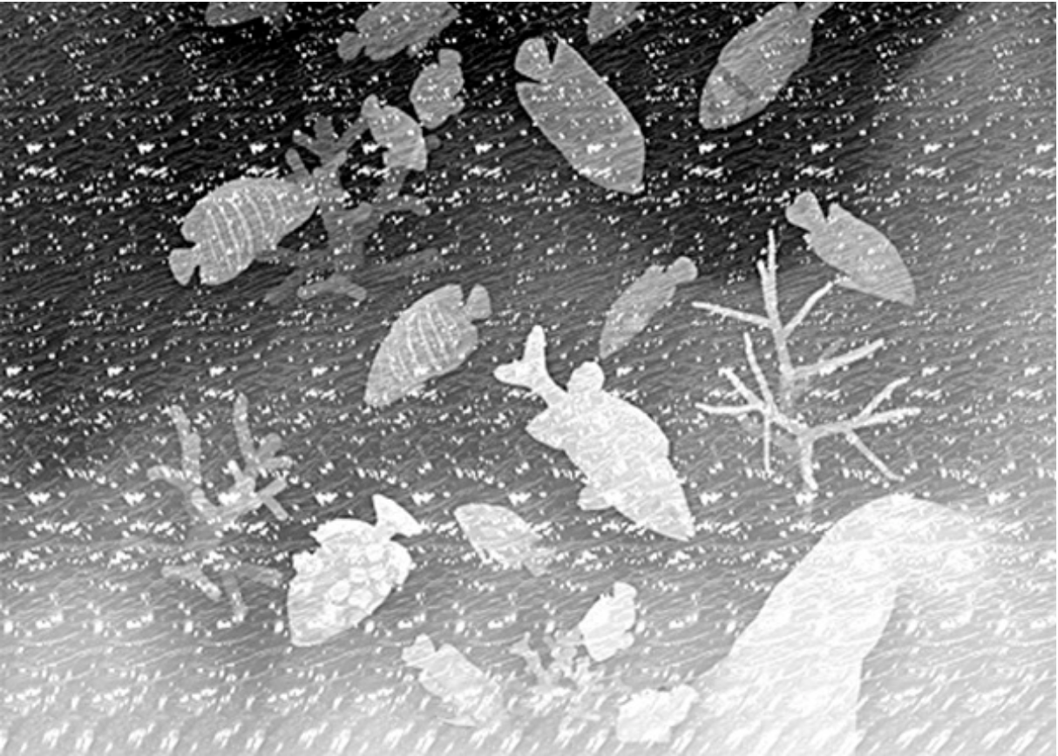

Slide 5
Introduction to Geography
Lesson 2. Geographical Perspectives

Slide 6
Lesson 2. Geographical Perspectives
Aims:
Recognize that differing perspectives on a topic or issue may exist;
Determine which perspectives might most significantly broaden understanding of an issue;
Plan and carry out appropriate steps to find another perspective.

Slide 7
What is a perspective?
Task 1. With a partner, discuss how the different people listed below each of the following photographs would react to or think about the photograph.
Notes:
Discuss responses to each picture

Slide 11
What is a perspective?
We have just been speculating about different perspectives on a particular event or object.
Each group reacting to the photographs would share common knowledge and values that would influence their perspective.
What is a perspective? Can you think of a definition?
Notes:
Discuss responses to each picture

Slide 12
What is a perspective?
“A particular attitude towards or way of regarding something.”
During this lesson, we will look at various perspectives on an event or issue and discover how considering different perspectives helps us broaden our understanding of an issue.
Notes:
Discuss responses to each picture

Slide 13
Stakeholders
In any issue there are a number of stakeholders that might provide important perspectives.
A stakeholder is a person, group, or organization that has a direct or indirect stake or interest in something.

Slide 14
The Importance of Perspective
As geographers need to actively seek out perspectives other than the one that is presented in a single source of information. To do this we might…
a) identify the perspective reflected in the source you already have;
b) brainstorm all the other stakeholders;
c) speculate how each stakeholders’ perspective might be different and why each perspective is important;
d) select those groups or individuals whose perspective is likely to be most different and be most useful in expanding your understanding of the issue or event;
e) brainstorm various places where you might find out information about each perspective;
f) actively search for the alternative perspective

Slide 15
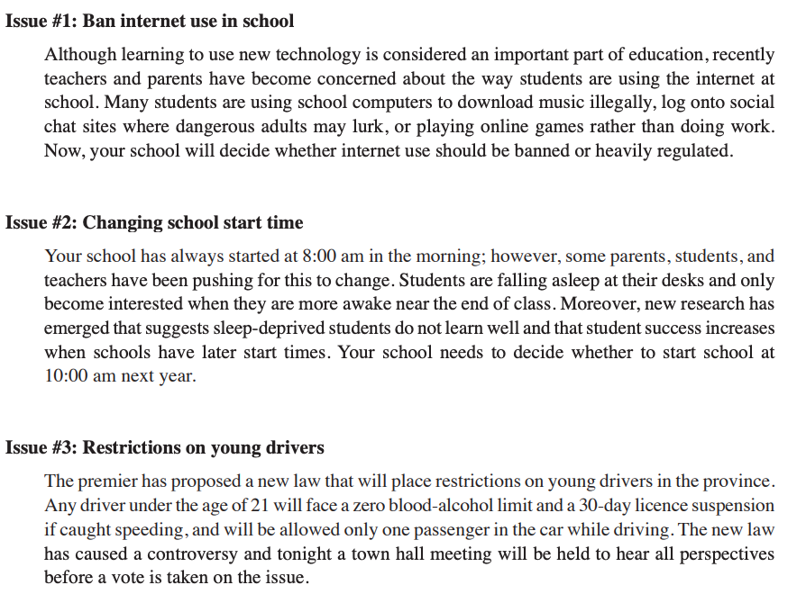
Finding Another Perspective
Task 2. We are going to examine a particular issue.
Step 1. Choose one of the issues provided on your worksheet.
Step 2.
Identify the perspective reflected in the source.
Notes:
Lesson 2 Finding another perspective (page 1 and 2)

Slide 16
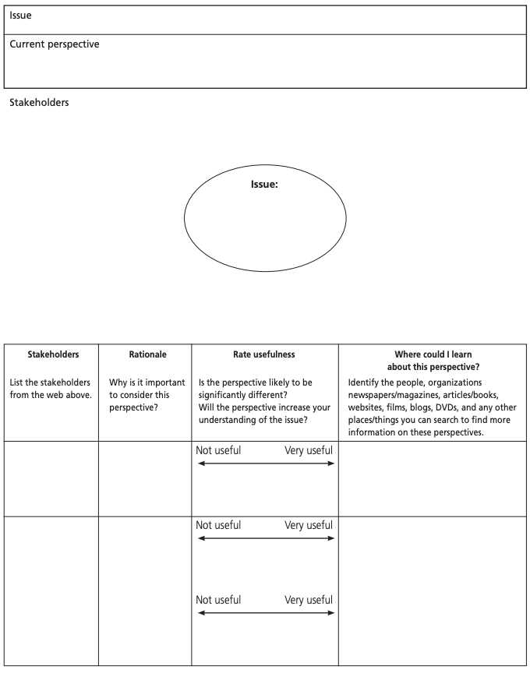
Step 2.
Brainstorm all the other stakeholders.
Speculate how each stakeholders’ perspective might be different and why each perspective is important.
Select those groups or individuals whose perspective is likely to be most useful in expanding your understanding of the issue or event.
Brainstorm various places where you might find out about each perspective.
Actively search for alternative perspectives.
Notes:
Lesson 2 Finding another perspective (page 1 and 2)
Sample answer: Page 3.

Slide 17
Why is this important?
Throughout this course, we are going to use this strategy in regular classroom situations, such as:
Examining relevant social issues;
Thinking about alternative ways of approaching a problem to be solved when doing group work;
Researching a particular topic to decide how to proceed on a pressing local, national, or global issue;
Resolving or avoiding conflict.

Slide 18
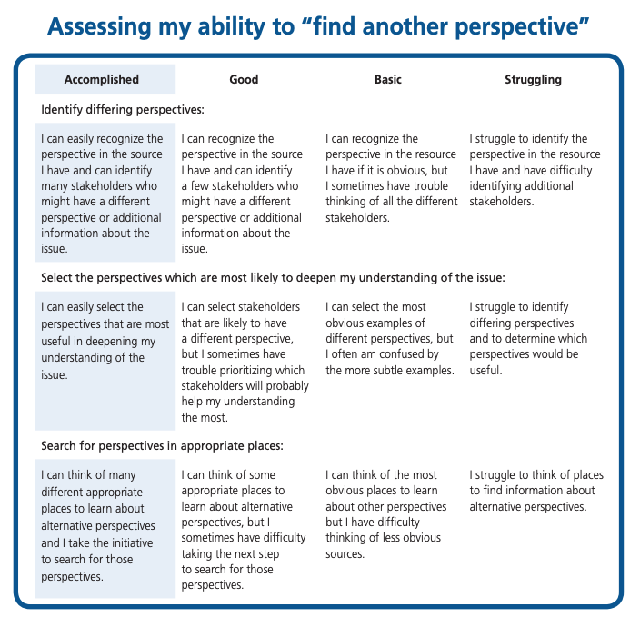
Review: Self Assessment
Thinking about yourself at this moment in time, how would you rate your ability to ‘find another perspective.’
Read the criteria on the sheet and decide which category you fall into.
Be honest!
Notes:
Lesson 2 Finding another perspective (page 4)

