Slide 1
I include this on slides where I would like my students to write
down the information into their notes. Use this at your discretion.
Class/paired/individual task Tasks for students are denoted in blue.
Class Brainstorm Class discussion tasks are denoted in green
Personalized information Information that is personal to my class/local area are denoted in purple and will need amending.
Key Words Key words pertinent to the course are denoted in red.
Notes Section Prompts for resource files needed for particular tasks, and any other additional information for the teacher will be given.

Slide 2
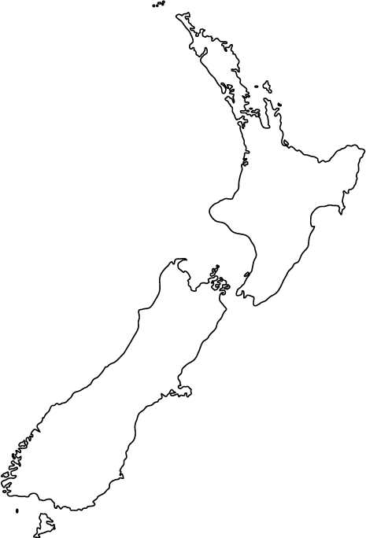
Country Conundrum!
New Zealand
Wellington
Oceania
Guess the country, capital city and
continent! This country…
Is in the Southern Hemisphere.
Is comprised of 2 main Islands.
Is situated in the South Pacific Ocean.
Is the 6th largest island nation in the world.

Slide 3
Starter…
“66.5 degrees”
What is significant about this number? What could our new topic be?
Notes:
Explain that we are going to be investigating The Arctic – the northernmost point on our planet.

Slide 4
Geography at 66.5 Degrees
Lesson 1.
The Most Northern Point on Earth

Slide 5
Lesson 1. The Most Northern Point on Earth!
Learning Goals:
Recap knowledge of the Earth.
Describe the location of the Arctic.
Recall key facts about the Arctic.

Slide 6
Task 1. True or False?
The Arctic is located at the southernmost point on our planet.
Polar bears and penguins both live in the Arctic.
The Arctic is colder than Antarctica.
The Arctic is not a country. It is actually a region made up of eight countries.
Because of the Earth’s tilt, at least one month a year is entirely in darkness in this freezing region — and also a full month of sunshine.

Slide 7
Task 1. True or False?
6. The Arctic is home to approximately 4,000 people.
7. In 1958, a submarine - USS Nautilus - sailed beneath the frozen
ice of the Arctic Ocean. This was proof that the enormous ice
sheet rests on water and not land.
8. One fascinating species found only in the Arctic is the narwhal,
often referred to as the ‘unicorn of the sea’.
9. The word ‘Arctic’ comes from the Greek word for bear, Arktos.
10. The ice of the Arctic contains around 20% of the world’s fresh
water.

Slide 8
Task 1. True or False?
The Arctic is located at the northernmost point on our planet.
Only Polar bears live in the Arctic. Penguins live in Antarctica.
The Arctic is warmer than Antarctica.
The Arctic is not a country. It is actually a region made up of eight countries.
Because of the Earth’s tilt, at least one day a year is entirely in darkness in this freezing region — and also a full day of sunshine.

Slide 9
Task 1. True or False?
6. The Arctic is home to approximately 4,000,000 people.
7. In 1958, a submarine called the USS Nautilus sailed beneath the
frozen ice of the Arctic Ocean. This was proof that the enormous
ice sheet rests on water and not land.
8. One fascinating species found only in the Arctic is the narwhal,
often referred to as the ‘unicorn of the sea’.
9. The word ‘Arctic’ comes from the Greek word for bear, Arktos.
10. The ice of the Arctic contains around 10% of the world’s fresh
water.

Slide 10
Task 2. The Arctic or Antarctica?
Many people get these two regions muddled up.
Watch this TedTalk to gain some handy tips on how to distinguish between the two!
Q. What are some misconceptions that you had about the poles?

Slide 11
Task 3. Global Geography Recap
Using Google Earth or an atlas, on your blank map of the world, label the following:
● Canada
● Lines of latitude and longitude
● Equator
● Tropic of Cancer
● Tropic of Capricorn
● Arctic Circle
● Northern Hemisphere
● Southern Hemisphere
● North Pole
● South Pole
● Arctic
● Antarctica

Slide 12
Task 4. Arctic Geography
Using Google Earth or an atlas, on your blank map of the Arctic Circle, label the following:
Arctic Circle Beaufort Sea
North Pole Hudson Bay
Arctic Ocean Baffin Bay
Canada Labrador Sea
Greenland Barents Sea
Finland Greenland Sea
Iceland Kara Sea
Norway Laptev Sea
Russia Chukchi Sea
Sweden East Siberian Sea
United States Norwegian Sea

Slide 13
Task 5. Locating the Arctic
Using the two maps that you have just created, write a description of the location of the Arctic.
Try to include:
Compass directions (north, south, east and west).
Lines of latitude and longitude.
Names of countries, seas and oceans.
Hemisphere.

Slide 14
Review: 5, 4, 3, 2, 1.
5 – countries in the Arctic!
4 – seas in the Arctic!
3 – continents that the Arctic is part of!
2 – names of the Tropics
1 – Greek name for the Arctic!

