Slide 1
I include this on slides where I would like my students to write
down the information into their notes. Use this at your discretion.
Class/paired/individual task Tasks for students are denoted in blue.
Class Brainstorm Class discussion tasks are denoted in green
Personalized information Information that is personal to my class/local area are denoted in purple and will need amending.
Key Words Key words pertinent to the course are denoted in red.
Notes Section Prompts for resource files needed for particular tasks, and any other additional information for the teacher will be given.

Slide 2
Numerical Nightmare!
When is 1500 plus 20 and 1600 minus 40 the same thing?
Notes:
Answer: Military time (1520)

Slide 3
Starter: Famous Faces of WWII
The next 9 slides, show famous leaders during WWII.
Guess:
The name of the leader
The country they lead

Slide 4
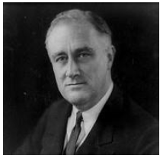
#1 Famous Faces of WWII
Franklin Roosevelt
USA

Slide 5
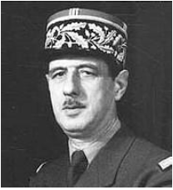
#2 Famous Faces of WWII
Charles de Gaulle
France

Slide 6
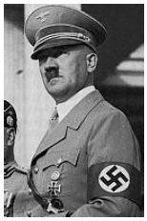
#3 Famous Faces of WWII
Adolf Hitler
Germany

Slide 7
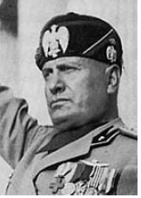
#4 Famous Faces of WWII
Benito Mussolini
Italy

Slide 8
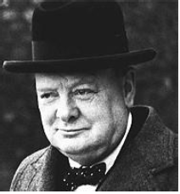
#5 Famous Faces of WWII
Winston Churchill
Great Britain

Slide 9
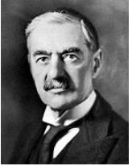
#6 Famous Faces of WWII
Neville Chamberlain
Great Britain

Slide 10
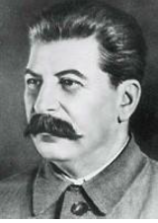
#7 Famous Faces of WWII
Joseph Stalin
USSR

Slide 11
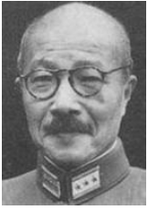
#8 Famous Faces of WWII
Hideki Tojo
Japan

Slide 12
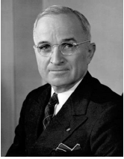
#9 Famous Faces of WWII
Harry Truman
USA

Slide 13
Canada | WWII
Lesson 1 | Introduction to WWII

Slide 14
Lesson 1 | Introduction to WWII
Learning Goals: * To name the key leaders of WWII. * To name the key countries in WWII. * To examine the role of key leaders in WWII.

Slide 15
Famous Faces Top Trumps
Task 1: You have all been given a famous leader character card. Keep this secret!
In your groups play a game of Top Trumps using the information on the card.
Try to guess which leader your teammates have.
Which leader scores the highest for the different areas?
Who is the best leader overall?

Slide 16
The Main Players in World War II
These 9 people were all key leaders of these main countries during WWII.
The two main sides were known as the Axis Powers and the Allied Powers.

Slide 17
Leaders in WWII
Before we get into the main causes, events and consequences of WWII, it is useful to know a bit more about the key leaders involved and how they came to power. The impact of WWI played a very significant part in the cause of WWII as we will soon find out…

Slide 18
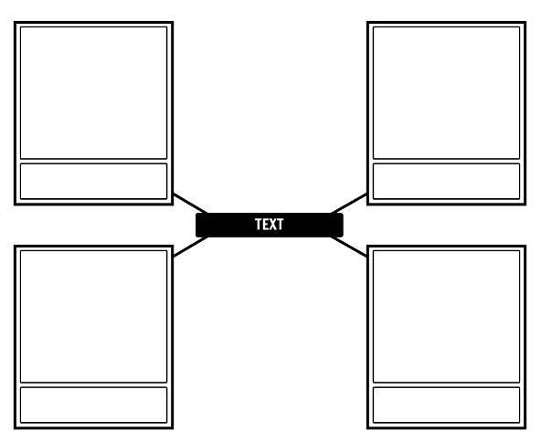
Leaders in WWII
Task 2: Key leaders Spider Map
You are going to create a spider map that
represents one of the key leaders in WWII.
For your selected leader, you should
include the following four aspects of
their life.
Life Before the War
Rise To Power
Role During World War II
Life After World War II

Slide 19
Leaders in WWII
For each of the four aspects, your will need to
create a visual representation that reflects that
period in their life.
You will also need to include a written description
below each visualization.
You may summarise events from reputable
Sources or include a quote directly from the
leader.

Slide 20
Leaders
Adolf Hitler
Joseph Stalin
Franklin Roosevelt
Harry Truman
Winston Churchill
Neville Chamberlain
Charles de Gaulle
Benito Mussolini
Hideki Tojo

Slide 21
Review | Group-Share-Discuss
Task 3: Presentations
Present the spider map of your chosen leader
to the rest of your table group.
Questions?
Have you any questions that you would like to ask
about your leaders and their contribution to
WWII?

